Slide 1
Mid-term: - Migration Name: -SIMPY SURI PROFESSOR: - Peter Wheeler
Subject: - Windows Administration

Slide 2
Server 2016 and Server 2012 need for migration
Server 2016: -
Computer Name: - WINSKANU9HB01
Domain Name: -suri.ca
Static IP Address: - 192.168.49.7
Initial DNS Address: - 192.168.49.5
Network Adapter: - Host-Only
Server 2012: -
Computer Name: - Server2012
Domain Name: - suri.ca
Static IP Address: - 192.168.49.5
Initial DNS Address: - 192.168.49.5
Network Adapter: - Host-Only

Slide 3
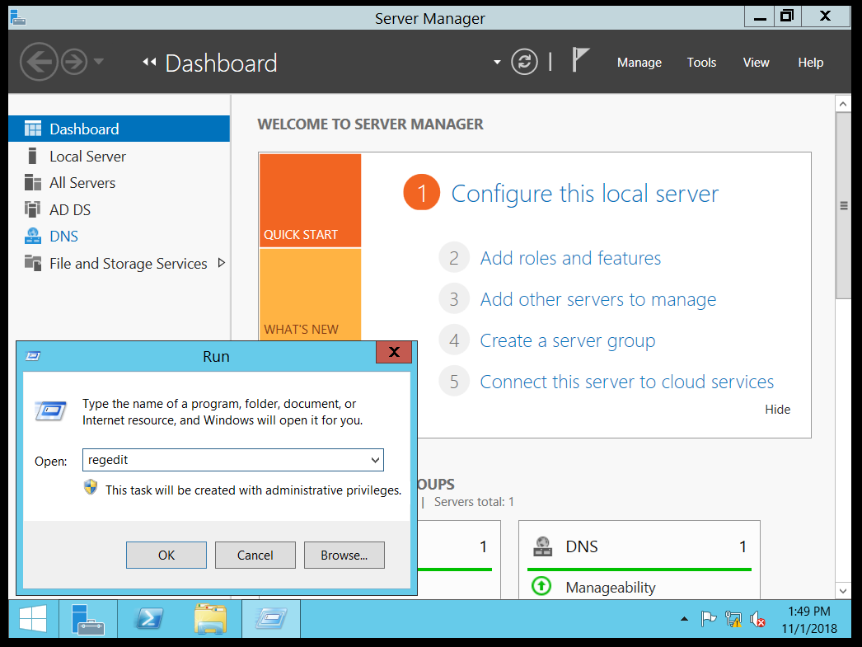
Step: 1 – Checking schema version of server2012. Go to server2012, press windows key + R, and then type “regedit” in Run.

Slide 4
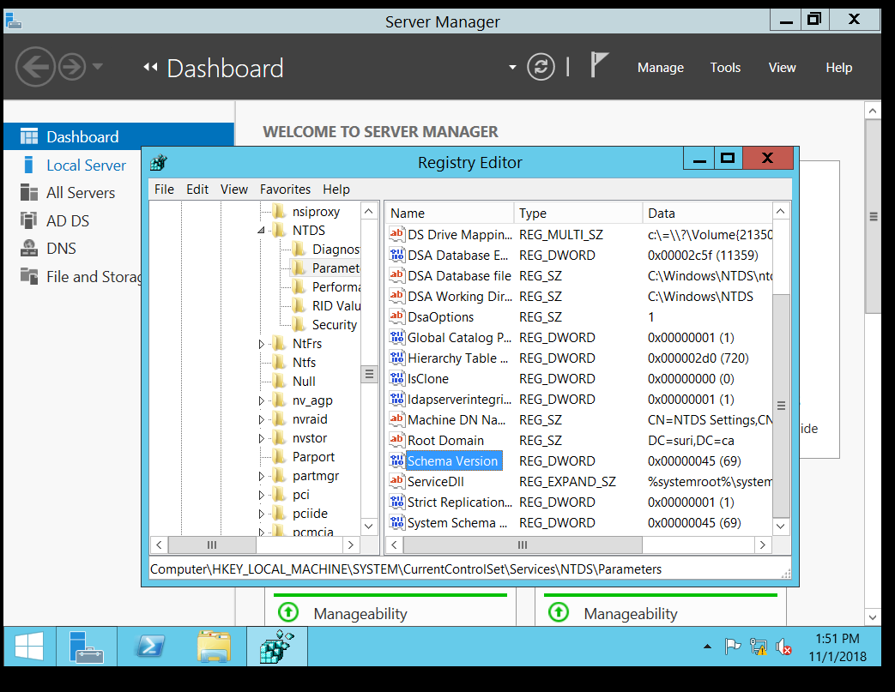
Step: 2 – Expand HKEY_Local_Machine>SYSTEM>CurrentControlSet>Services>NTDS>Parameters. Here you can see schema version is 69.

Slide 5
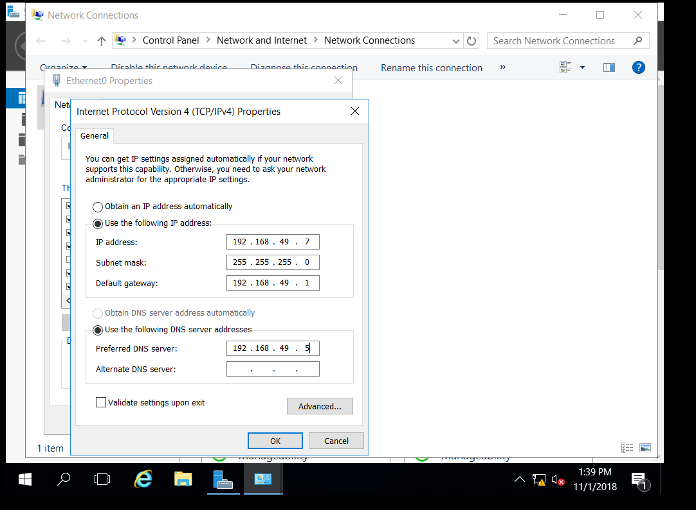
Step: 3 – Go to server2016. Open Network and Sharing Center. Click on IPv4, and then click on Properties. Here the DNS server address should be same as server2012.

Slide 6
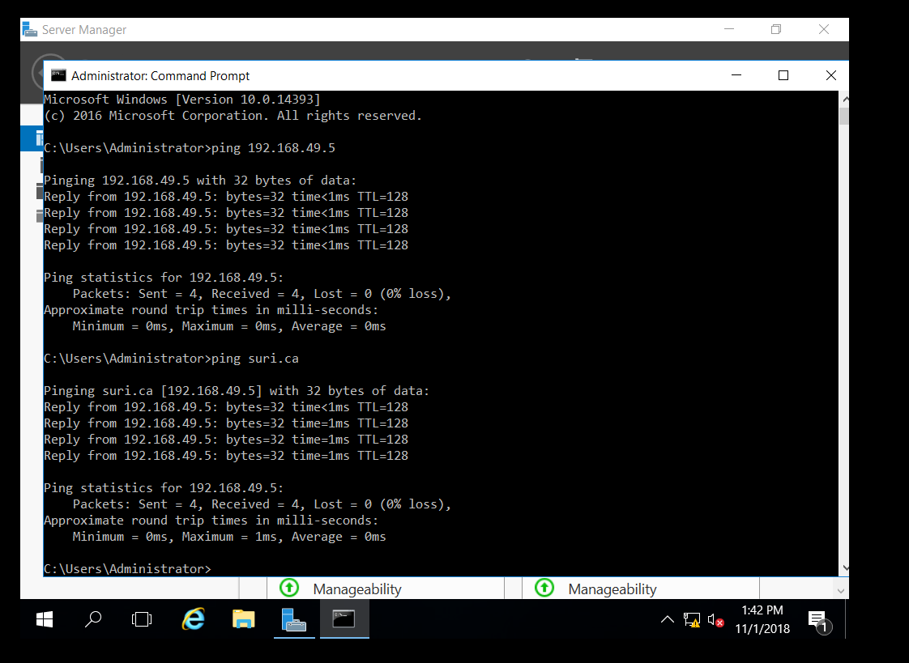
Step: 4 – Testing the connection in server2016. Open command prompt. Ping to server2012 with its IP address, and then ping to its server (in my case my 2012 server name is sURI.ca)

Slide 7
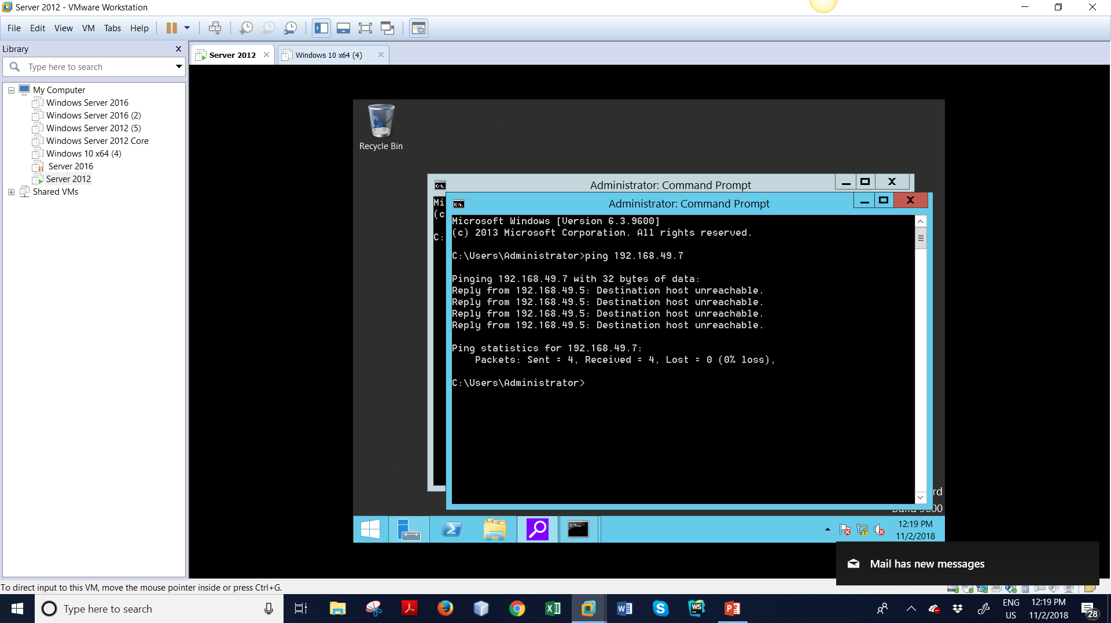
Step: 5 - Testing the connection in server2012. Open command prompt, ping to server2016 with its IP address.

Slide 8
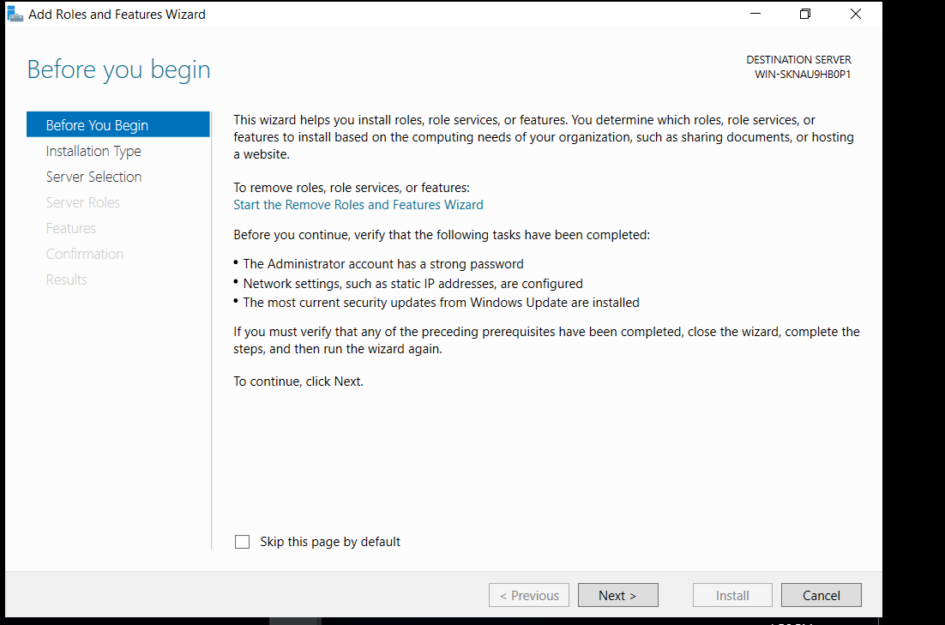
Step: 7 – On Select Installation Type, select Role-based or feature-based Installation. Click Next then.

Slide 9
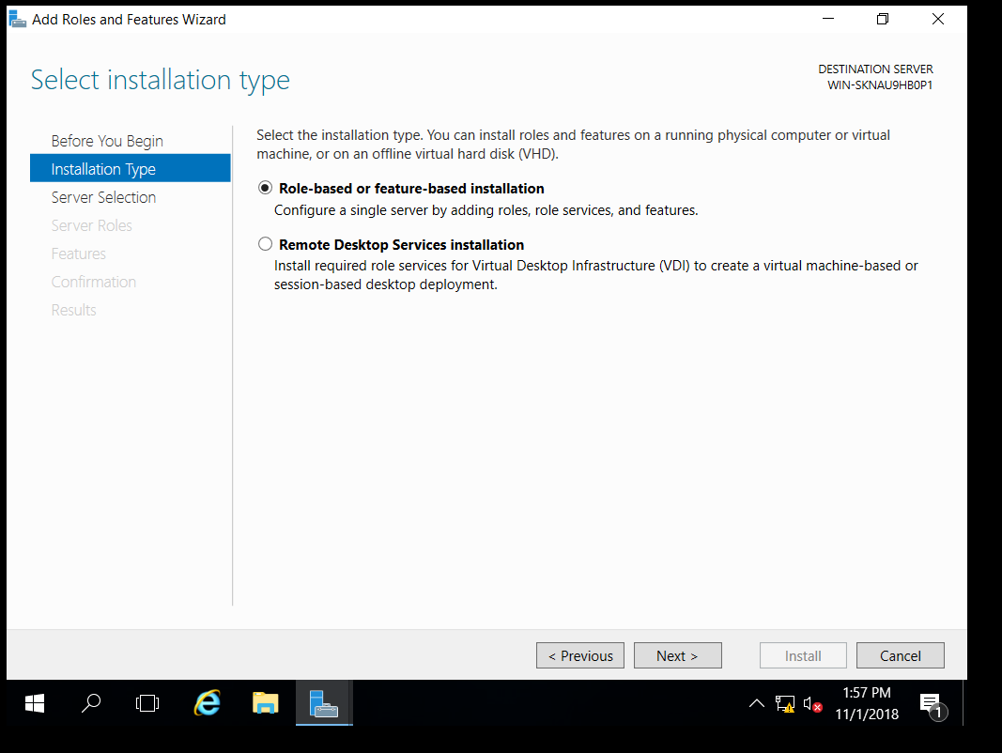
Step: 6 Adding Roles and Features in server 2016. Open Server Manager. Click on Tools>Add Roles and Features.

Slide 10
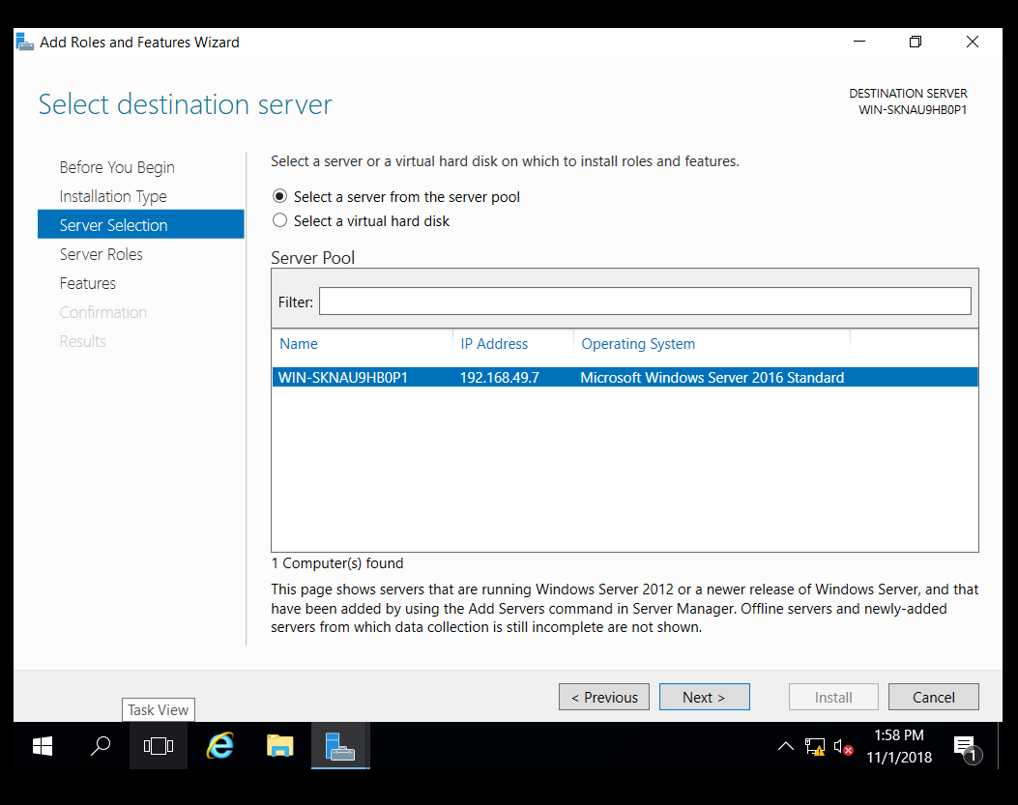
Step: 7 – On Server Selection page, ensure “Select a server from the server pool”. Click Next then.

Slide 11
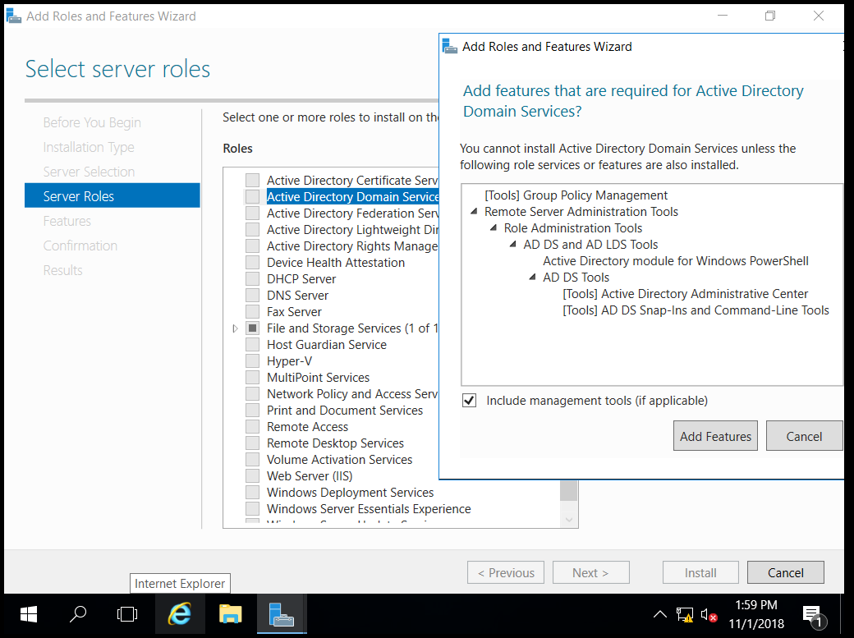
Step: 8 – On Server Roles page, click on checkbox beside “Active Directory Domain Service”. It’ll open Add Features dialogue box, click on Add Features.

Slide 12
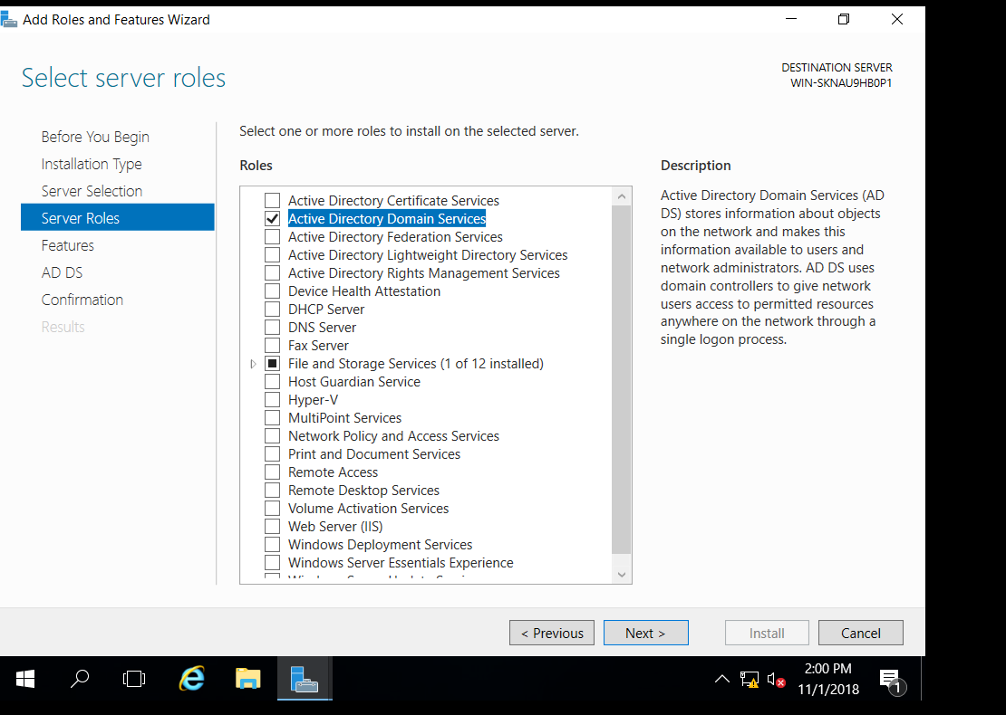
Step 9 :- Select active directory domain services and click next

Slide 13
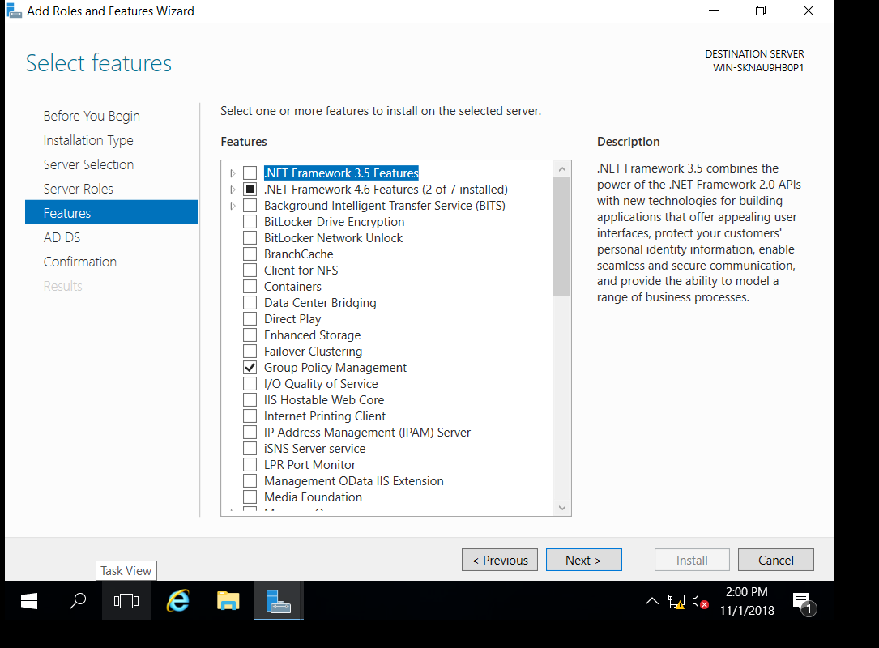
Step 10 : - Select .net framework 4.6 and click next

Slide 14
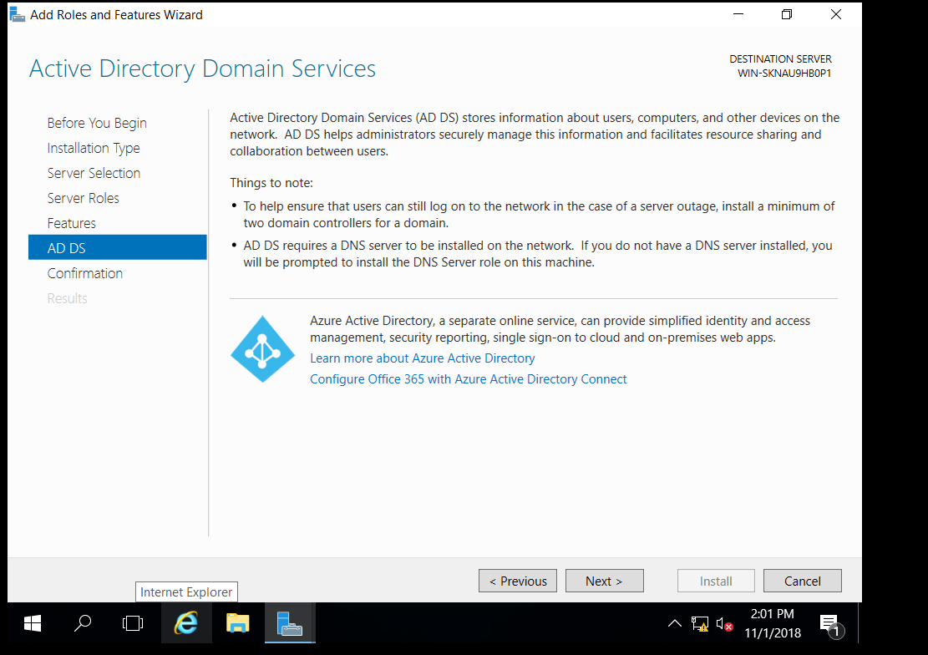
Step 11: - Window should show active directory domain services and click next

Slide 15
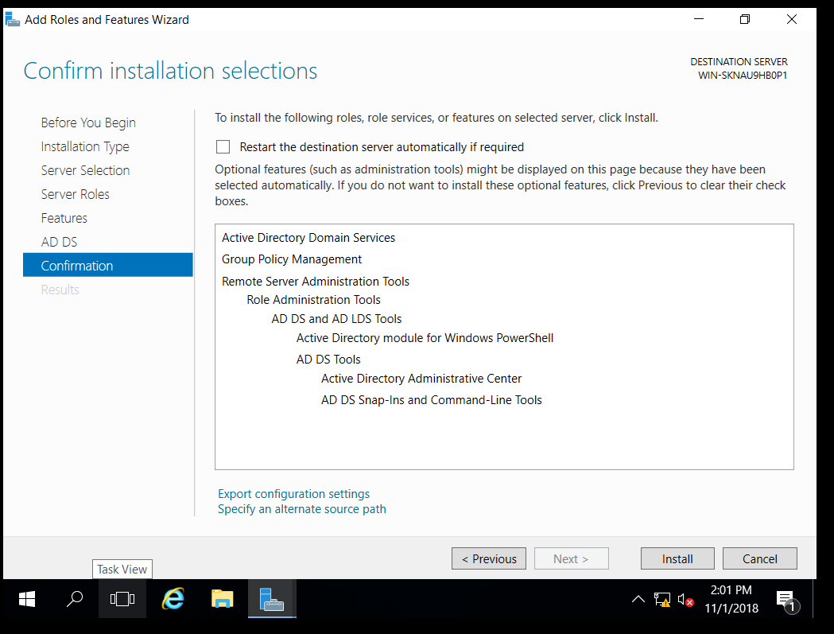
Step: 12 – On Confirmation page, click on Install.

Slide 16
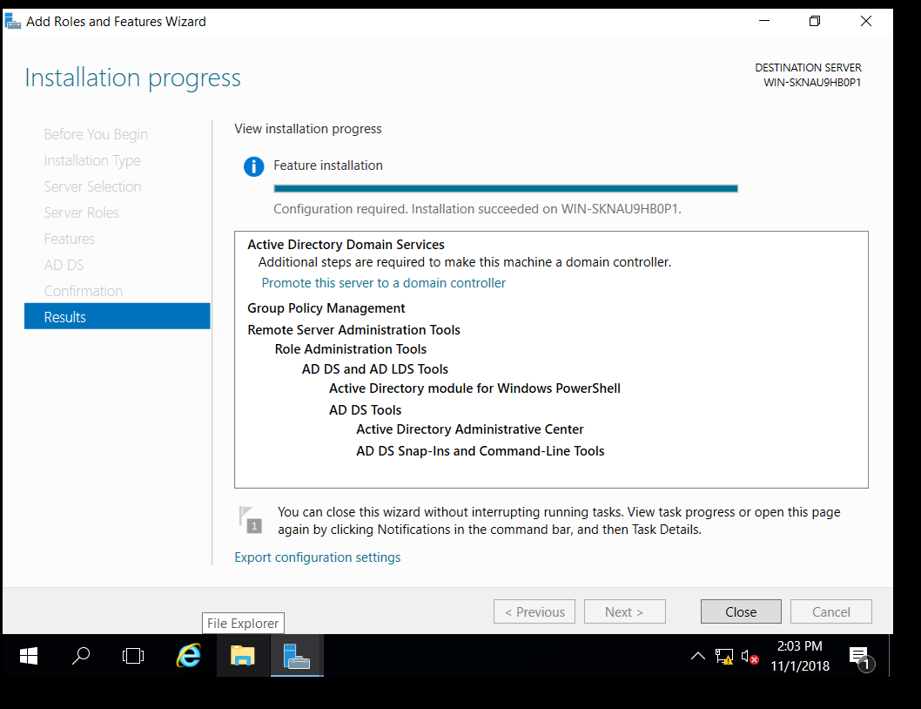
Step 13: – Installing in process.

Slide 17
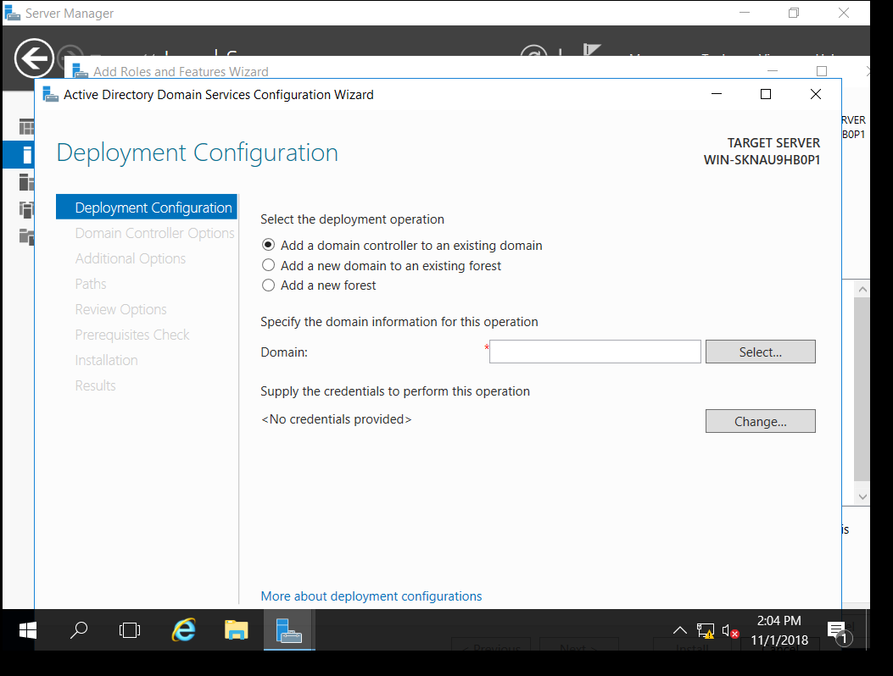

Slide 18
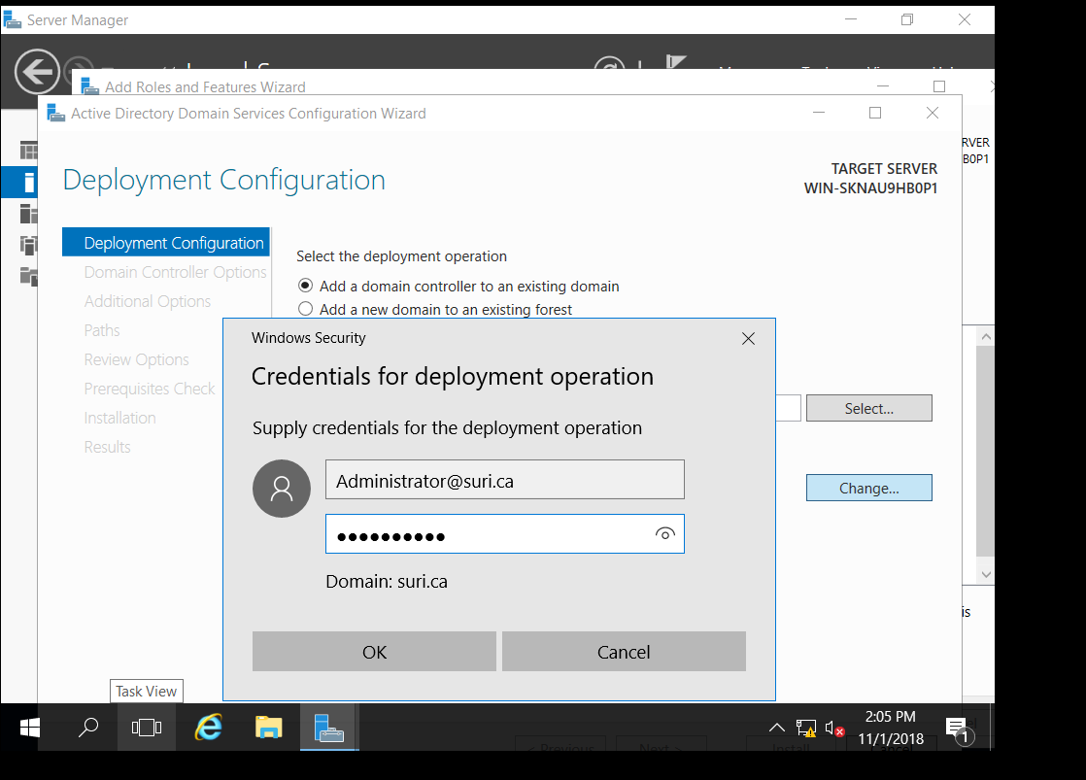
Step: 14 & 15 – In Deployment Configuration window, click on “Add a domain controller to an existing domain”. After that, click on Change button at bottom. In credential deployment operation dialogue box, type “Administrator@SURI.ca” and password.

Slide 19
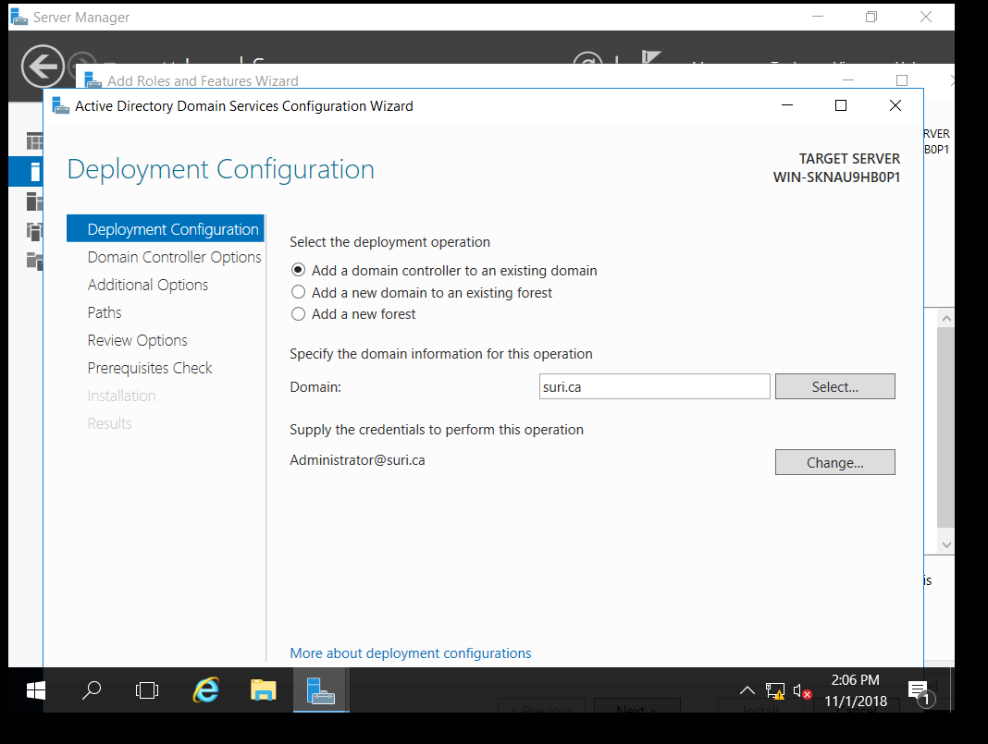
Step: 16– Click on Next.

Slide 20
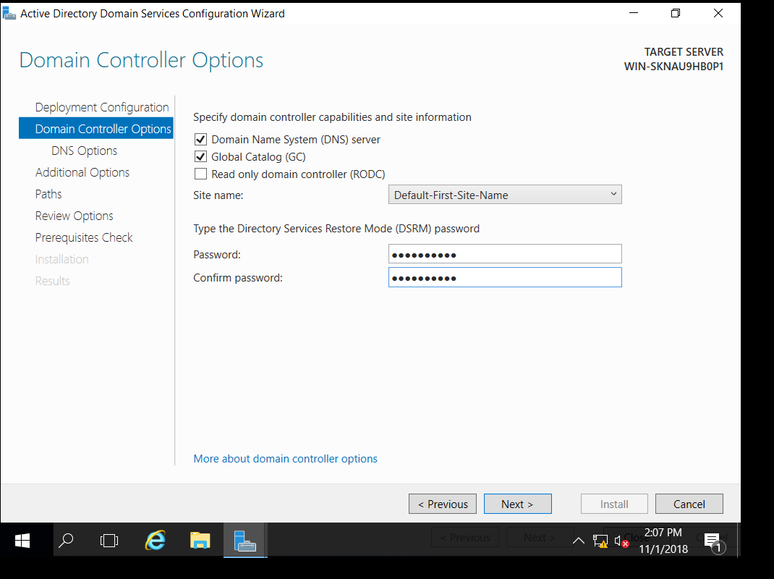
Step: 17 – On domain controller option page, check the “Domain Name System (DNS) server” and “Global Catalog (GC)”. Leave site name as it is. Give password and click Next.

Slide 21
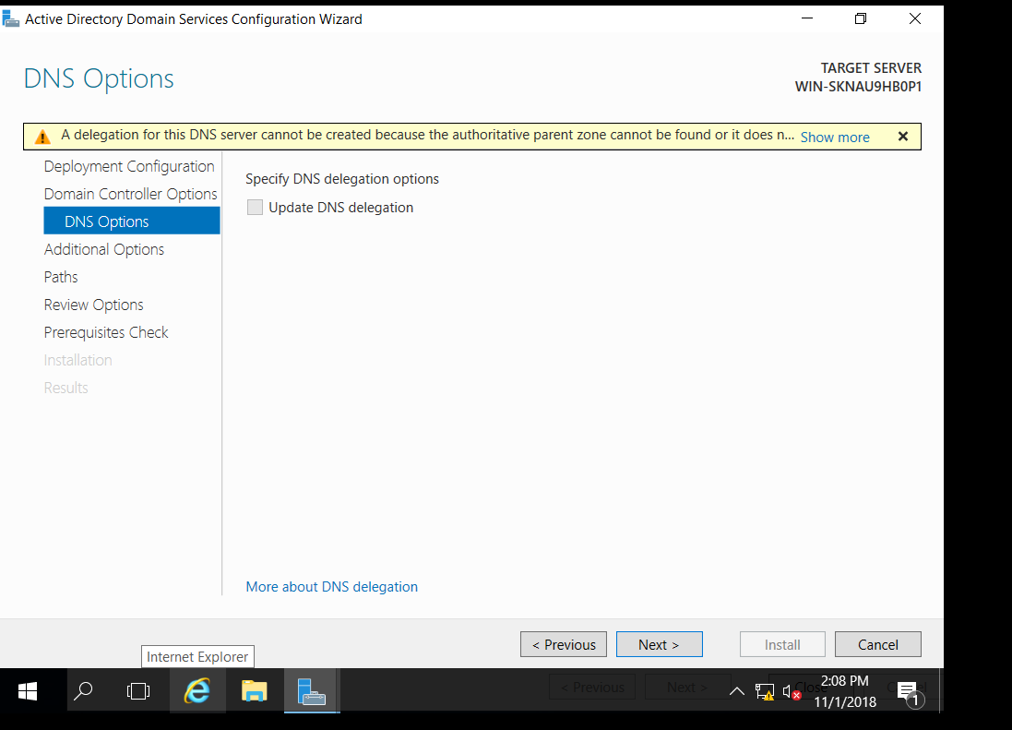
Step: 18- click Next.

Slide 22
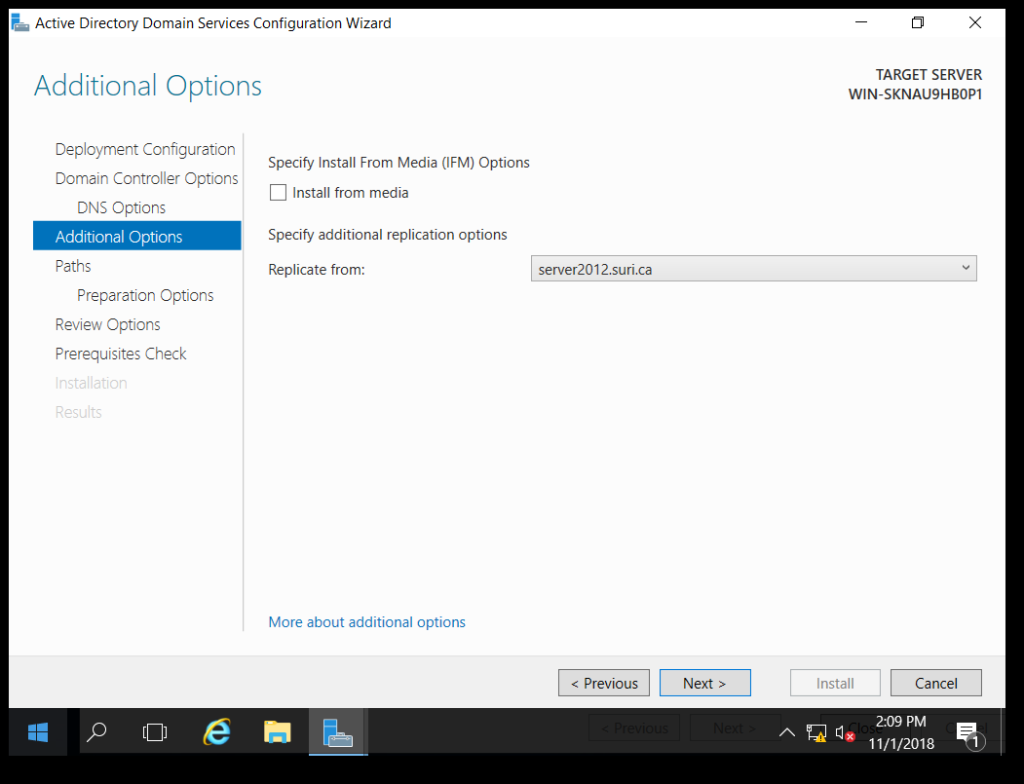
Step: 19 – On Additional Options page, choose server2012.suri.ca from Replicate option. server2012 is my 2012 server computer name, suri.ca is 2012 server name.

Slide 23
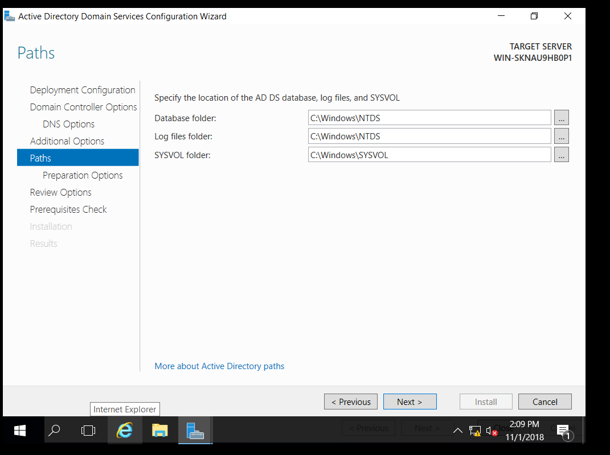
Step 20: Leave default setting as it is. Click Next then.

Slide 24
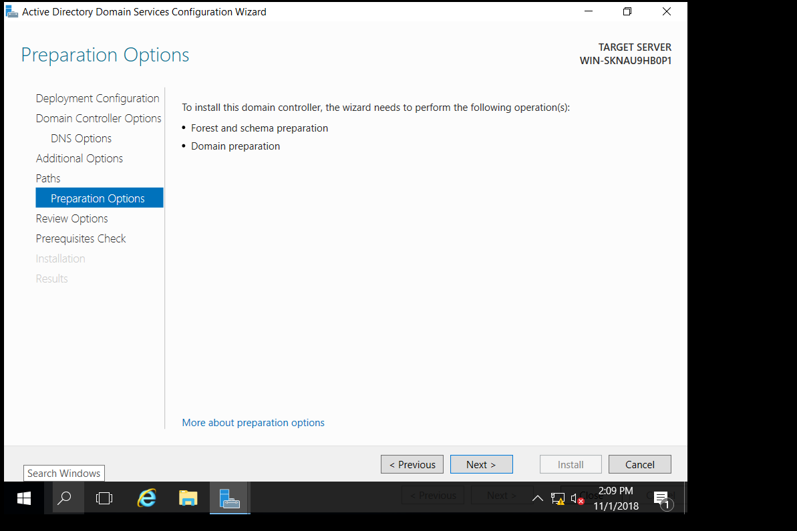
Step 21: Click Next.

Slide 25
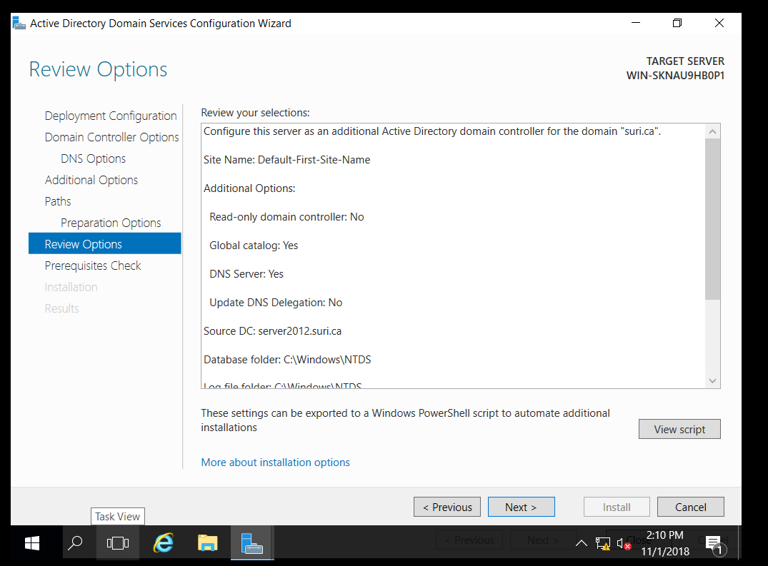
Step 22: – Review all the setting . Click Next .

Slide 26
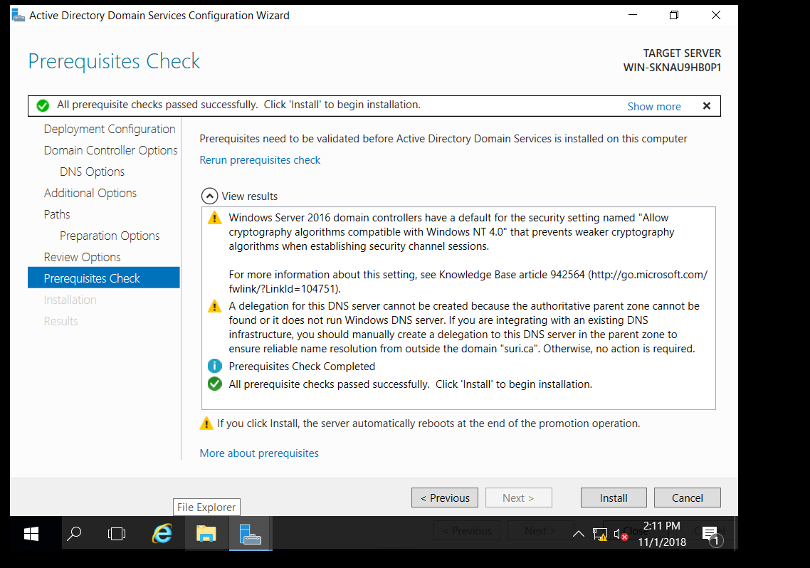
Step 23: After prerequisite check gets successful, click Install.

Slide 27
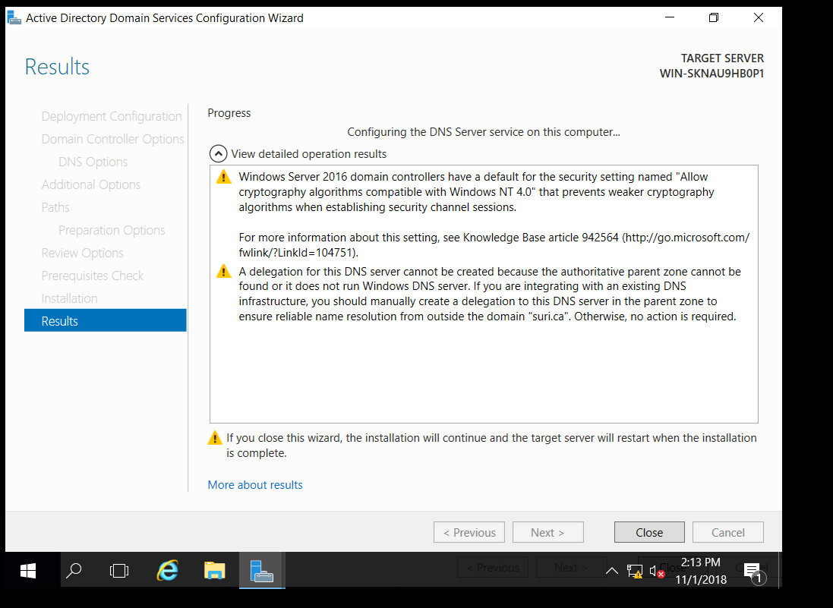
Step 24: After completing the installation, it will restart automatically

Slide 28
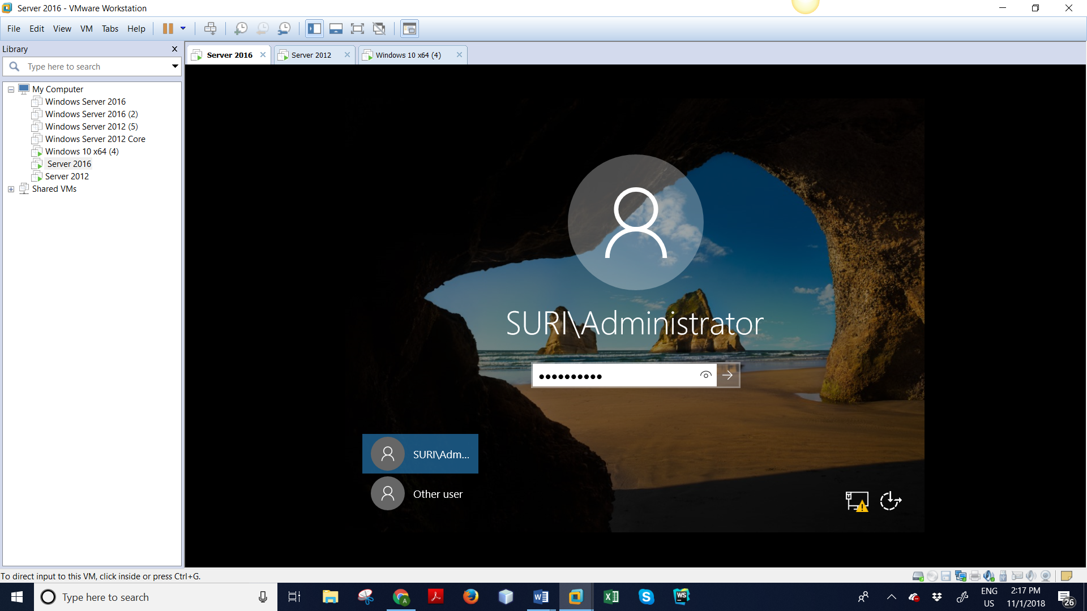
Step 25: After rebooting is completed, login on server 2016 with the password of server 2012.

Slide 29
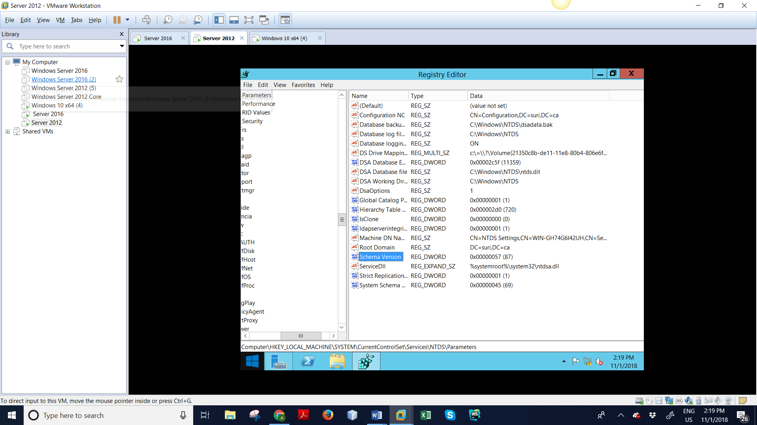
Step 26: go back to server 2012. Check schema version, which we checked in the beginning. Now it’s changed from 69 to 87.

Slide 30
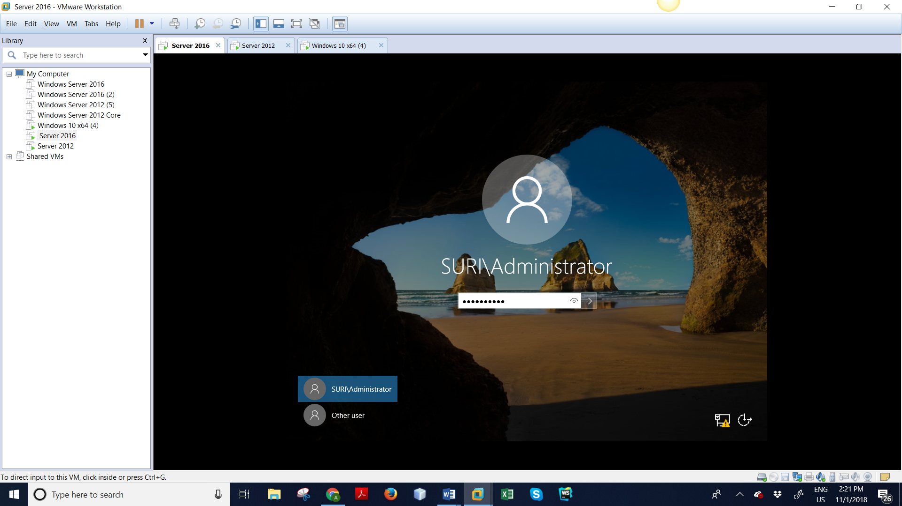
Step 27: Go back to server 2016.

Slide 31
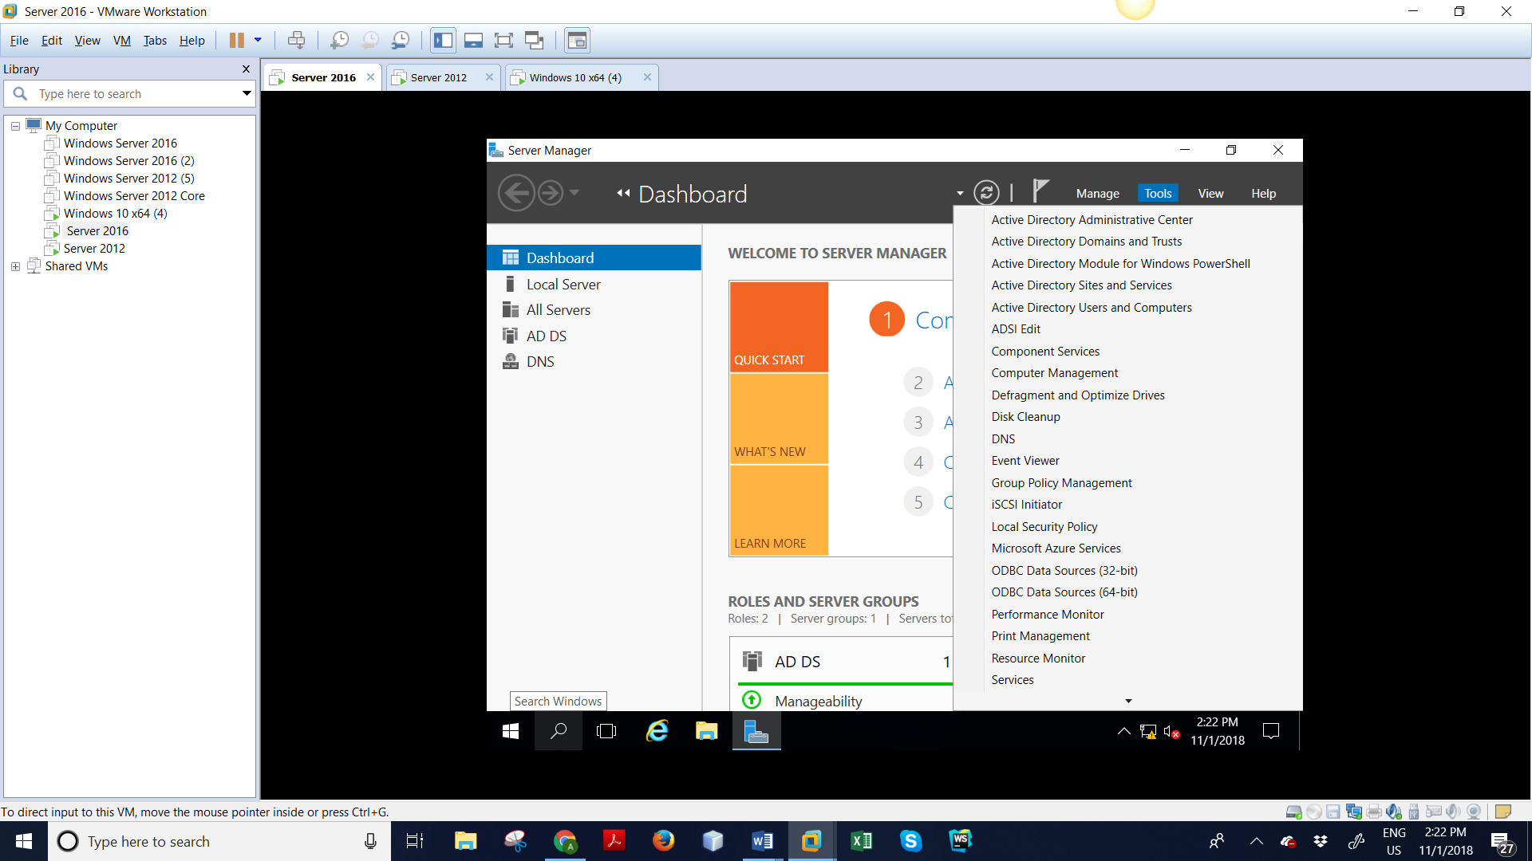
Step 28: Open server manager, click on Tools > Active Directory Users and Computers.

Slide 32
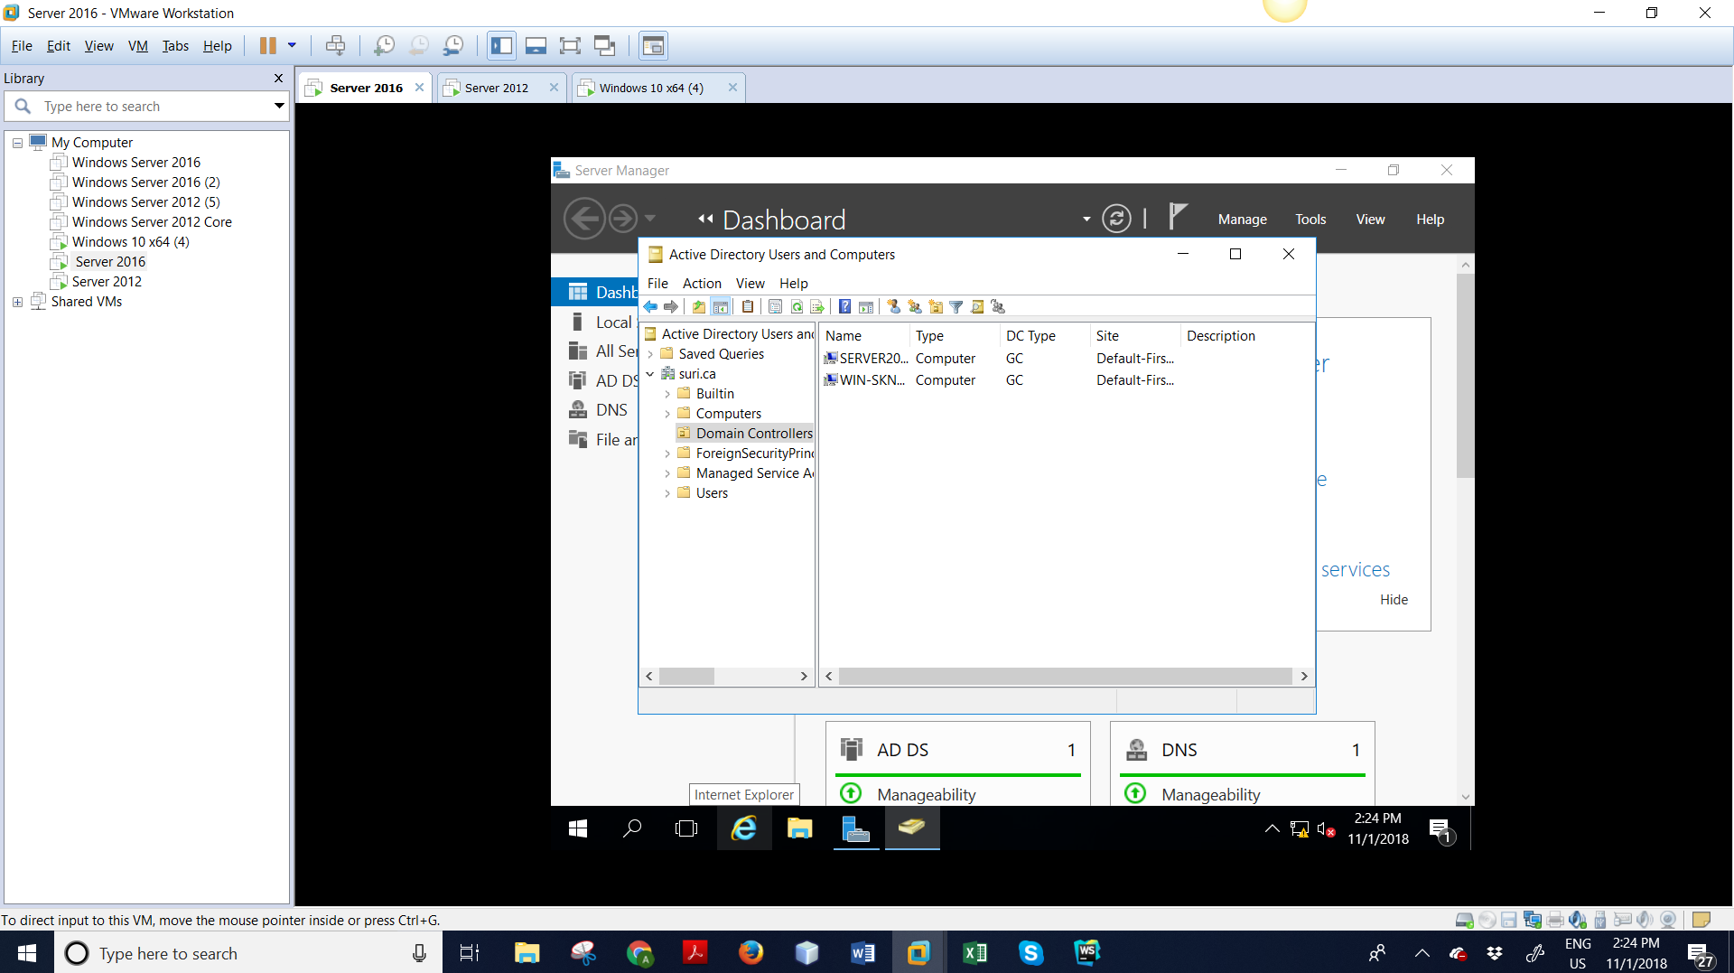
Step 29: Expand domain name, click on Domain Controller.

Slide 33
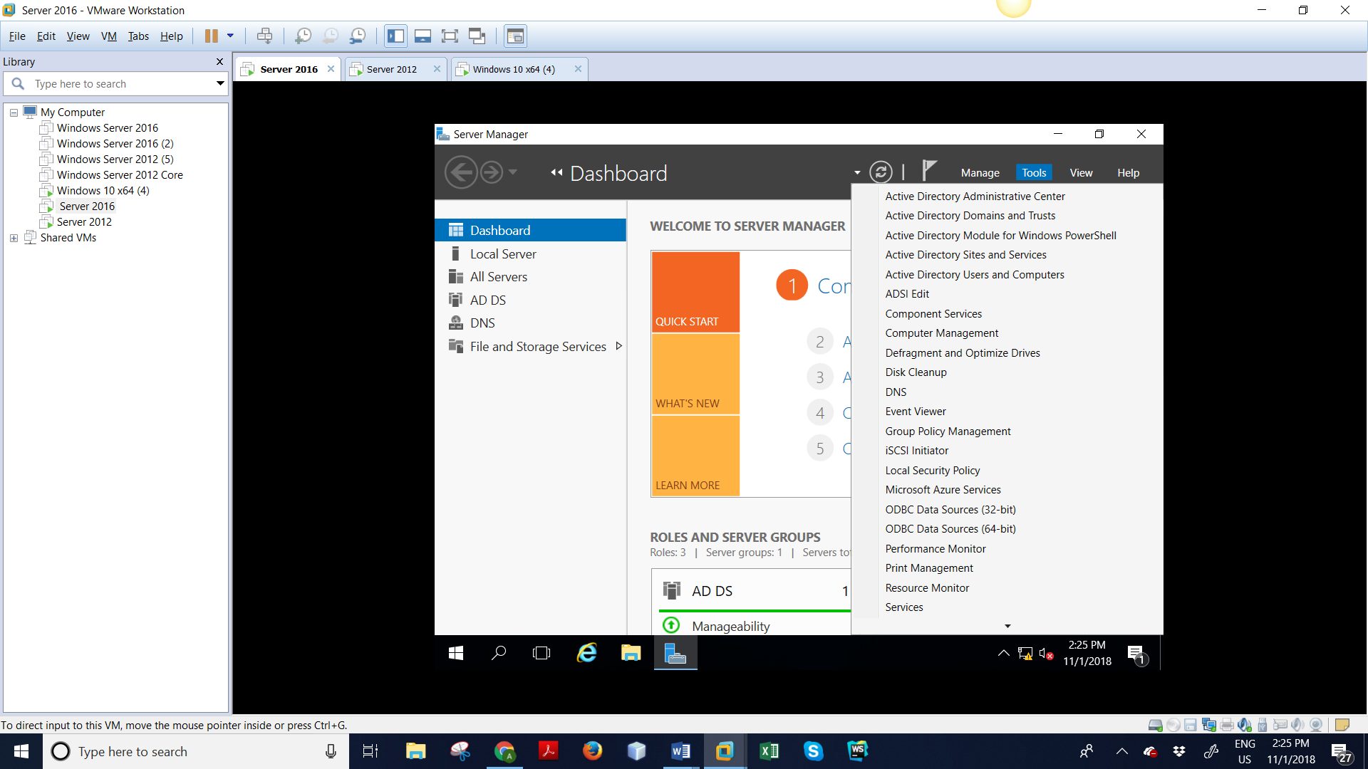
STEP 30: Click on Tools > DNS.

Slide 34
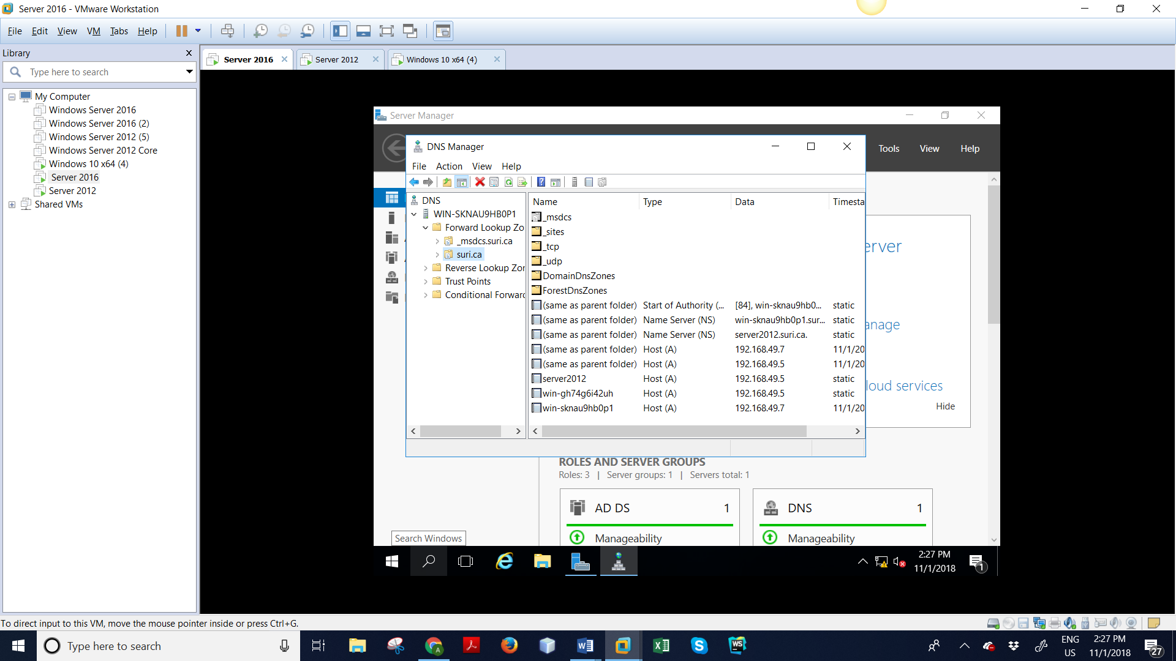
Step: 31– Checking DNS working for both the server. Expand server 2016 > Forward Lookup Zones > Right click on SURI.ca and select properties.

Slide 35
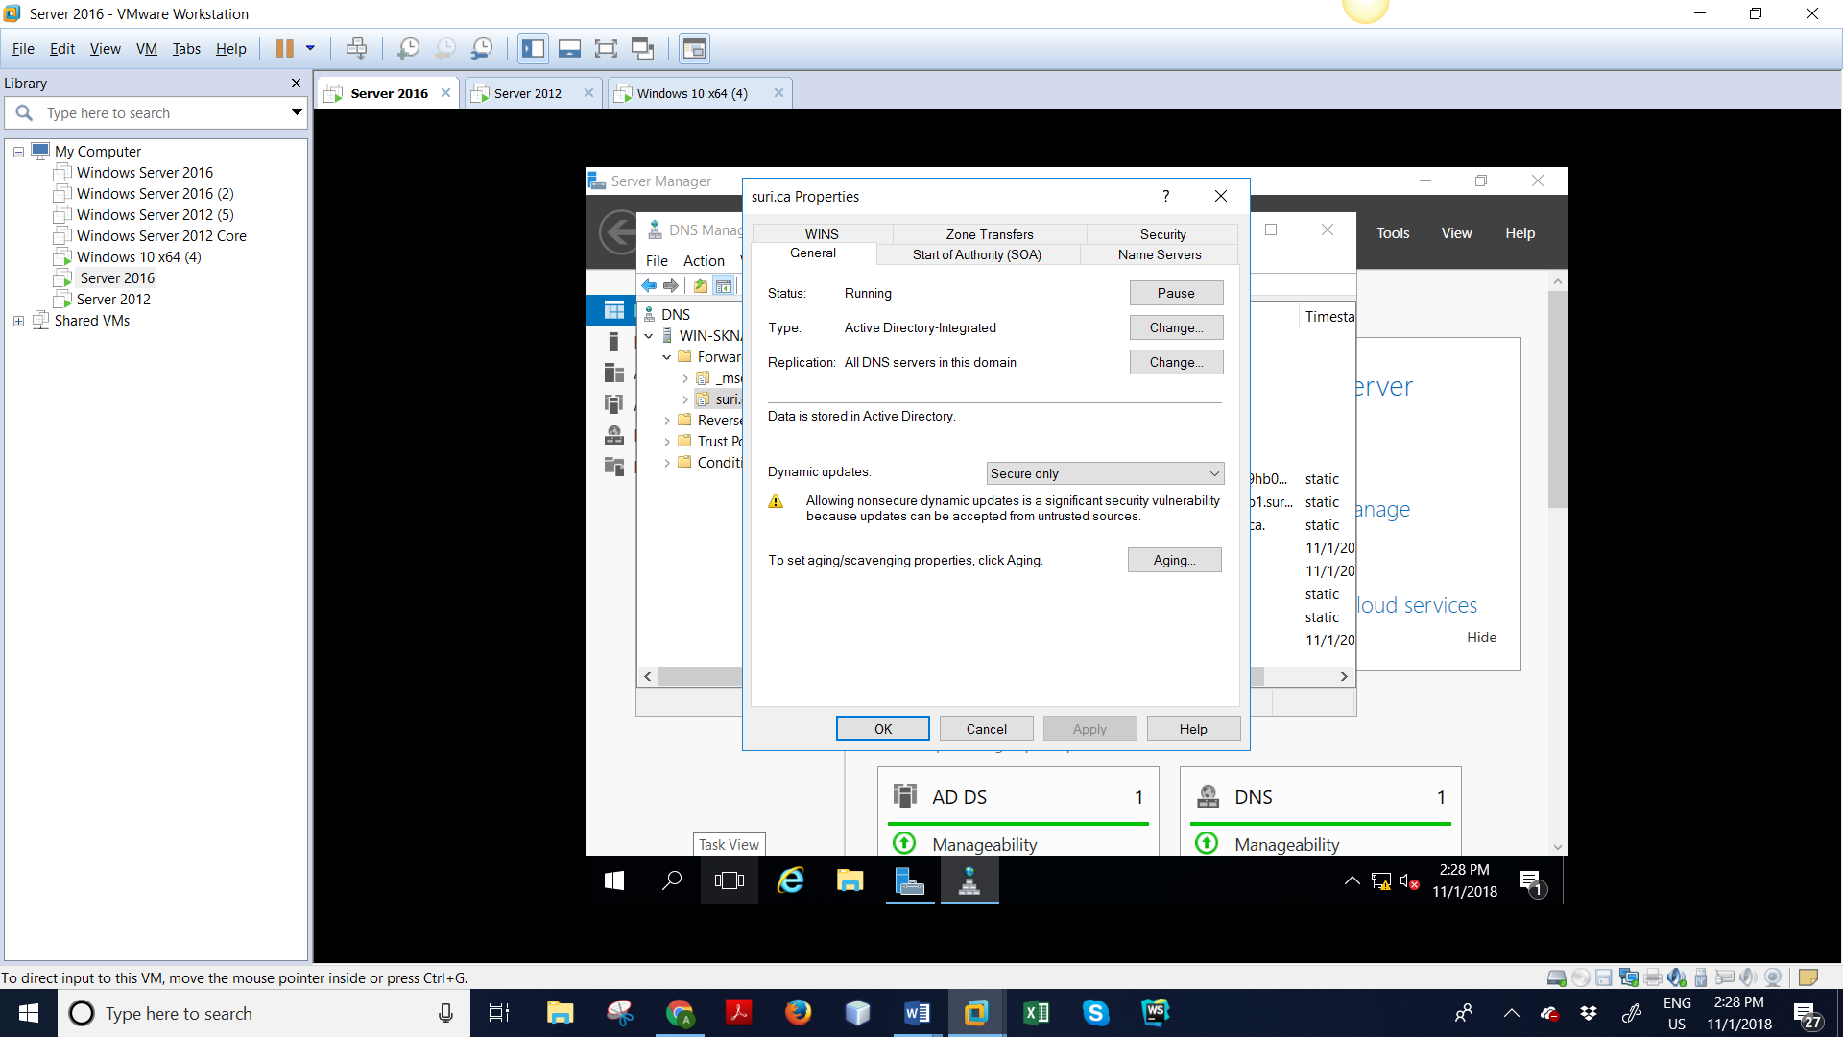
Step: 32 – Click on Name Servers tab, click Ok.

Slide 36
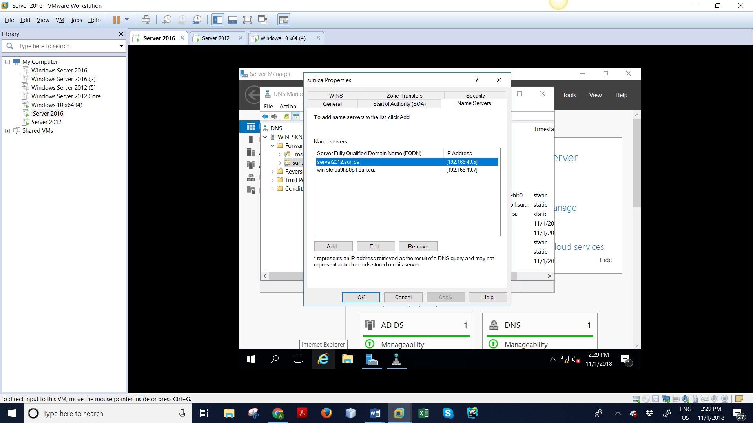
Step: 33 – Click on Name Servers tab, click Ok.

Slide 37
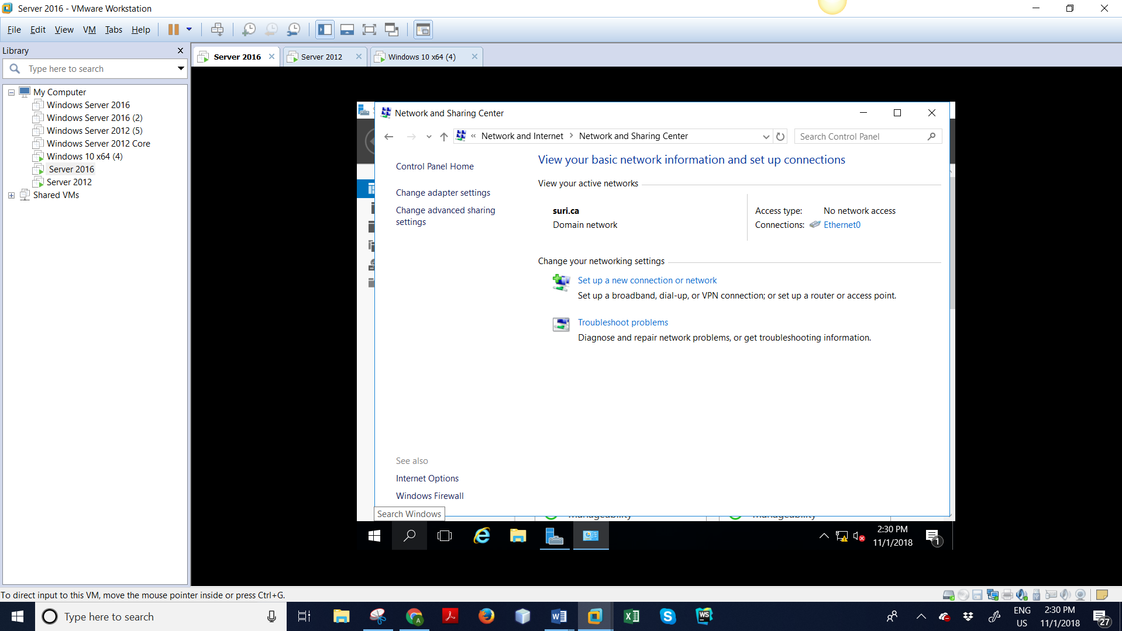
Step: 34 – TO CHANGE DNS address GO TO server 2016.

Slide 38
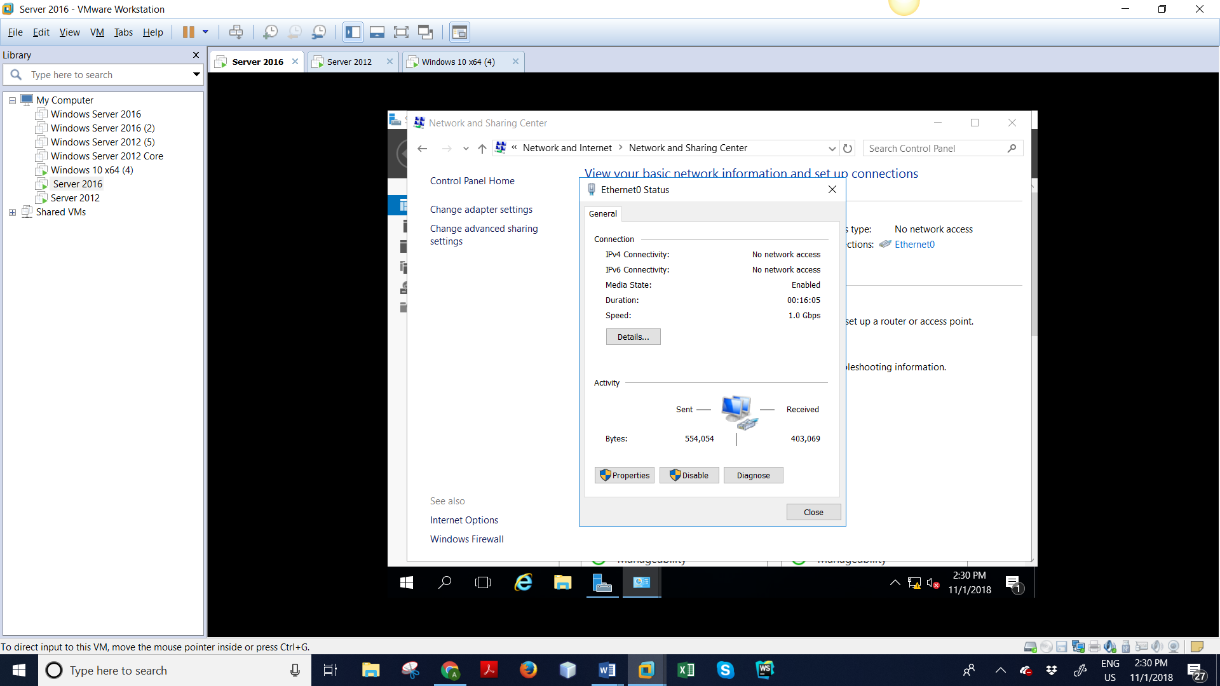

Slide 39
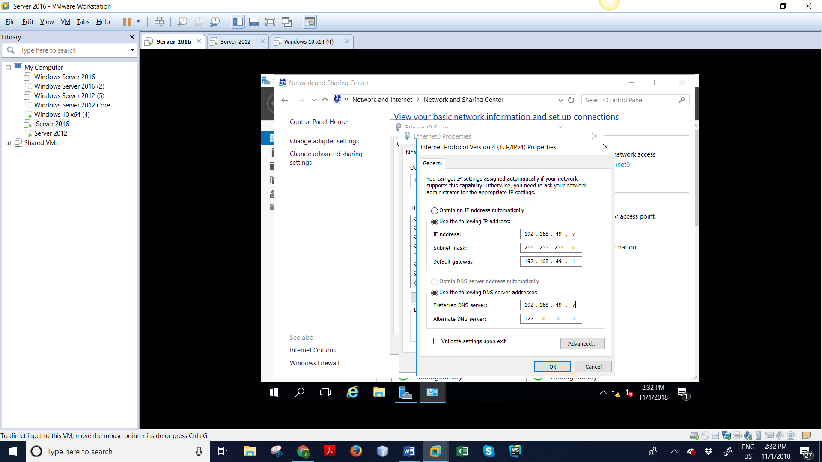
Step: 35– Changing DNS address for server 2016.

Slide 40

Step: 36– Click on Tools > Active Directory Sites and Services

Slide 41
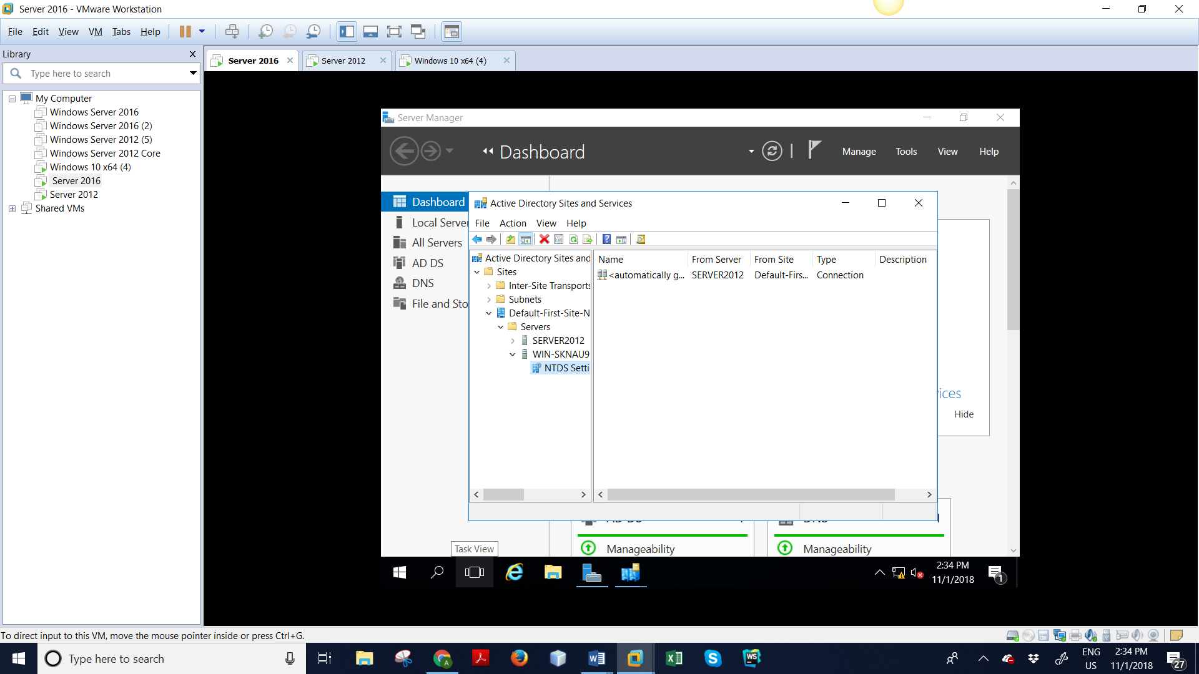
Step: 37– Expand Sites > Default-First-Site-Name > Servers > NTDS Settings

Slide 42
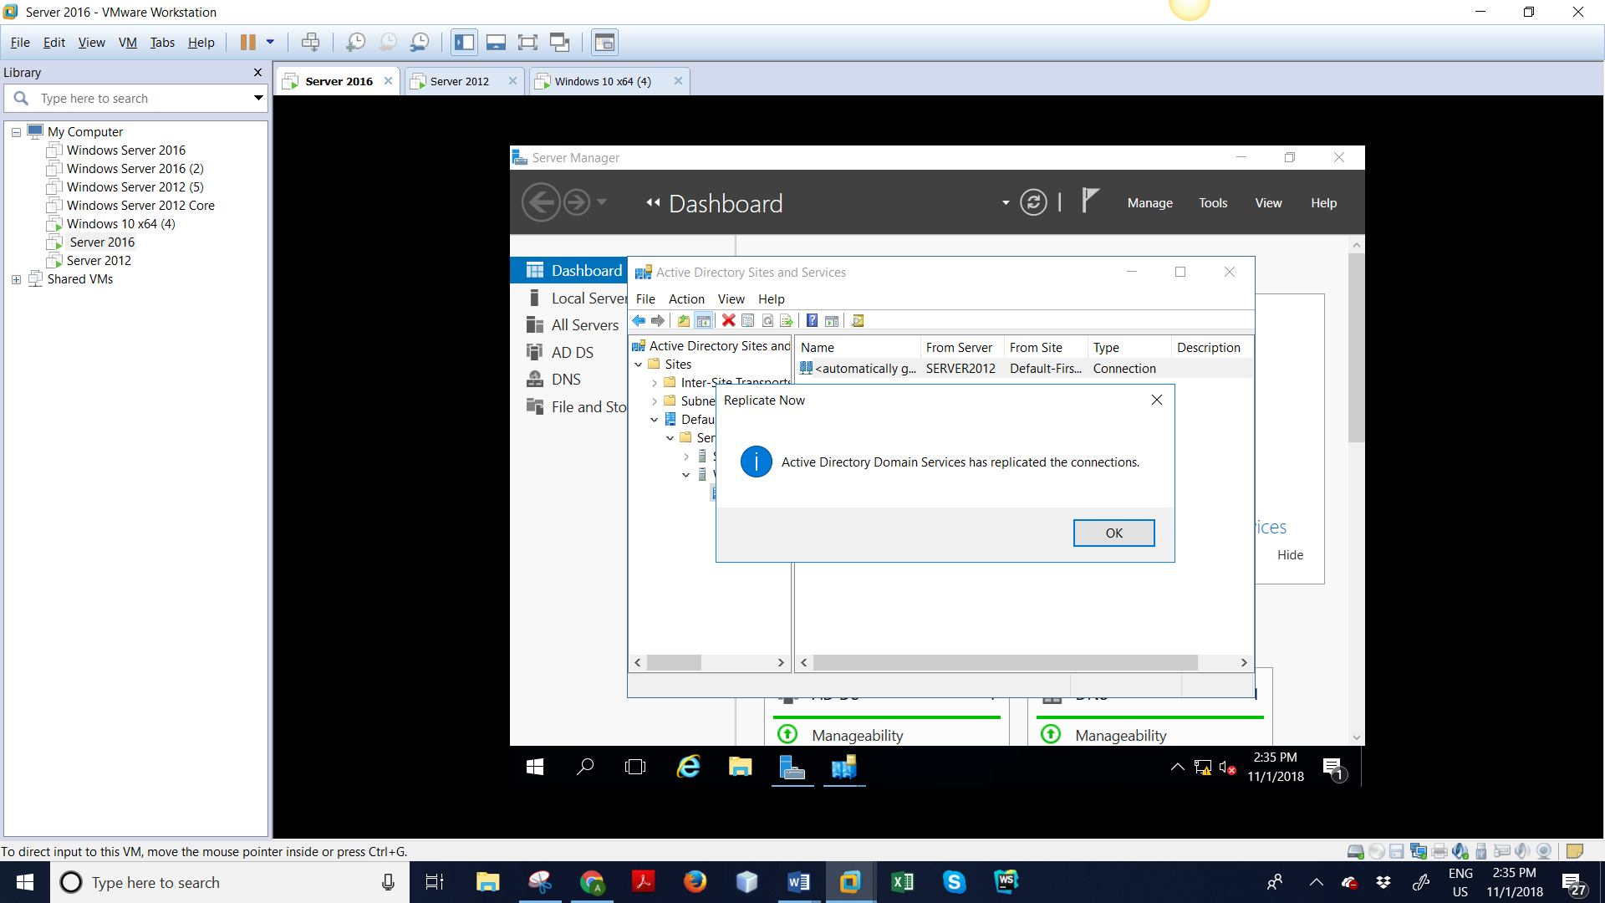
Step: 38– Right click on “automatically generated link” and click on “Replicate Now”

Slide 43
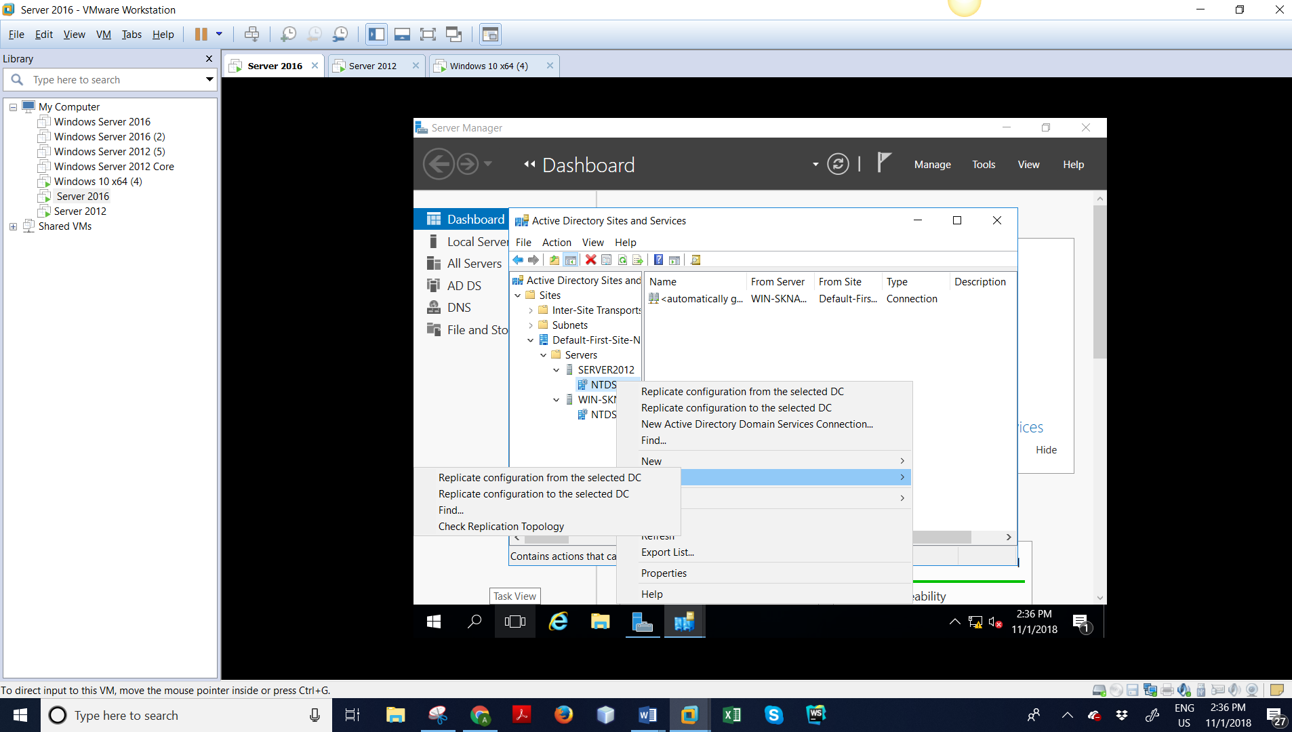
Step: 39– Click Ok

Slide 44
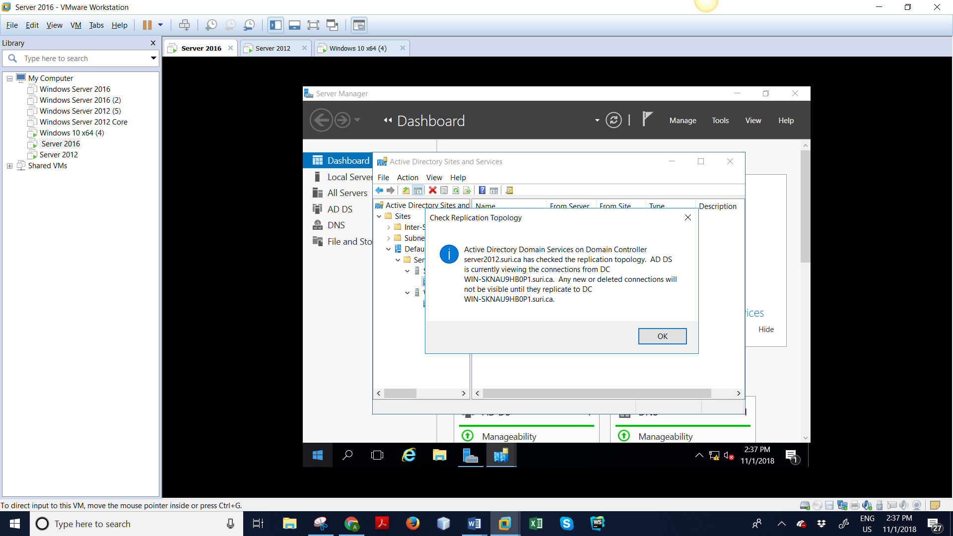
Step: 35 - Expand SURI> click on Check Replication Topology

Slide 45
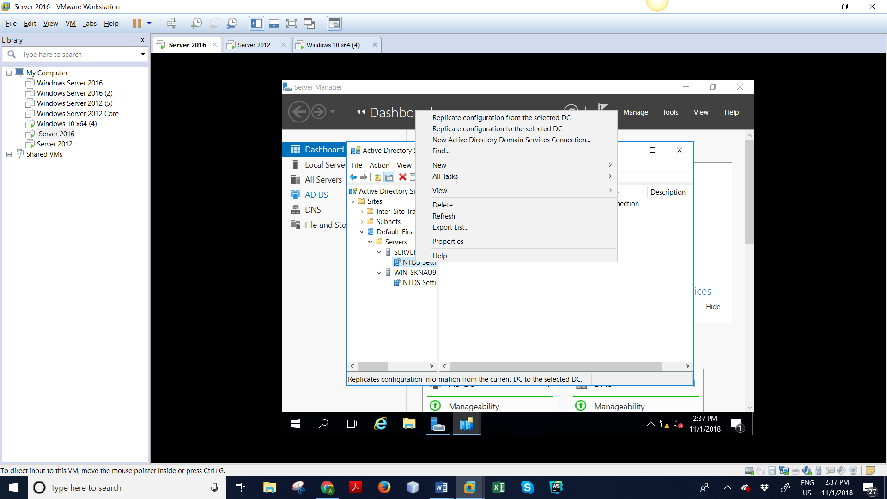
Step: 36 – Click on “Replicate configuration from the selected DC”

Slide 46

Step: 37 – Click on Replicate configuration to the selected DC AND CLICK OK

Slide 47
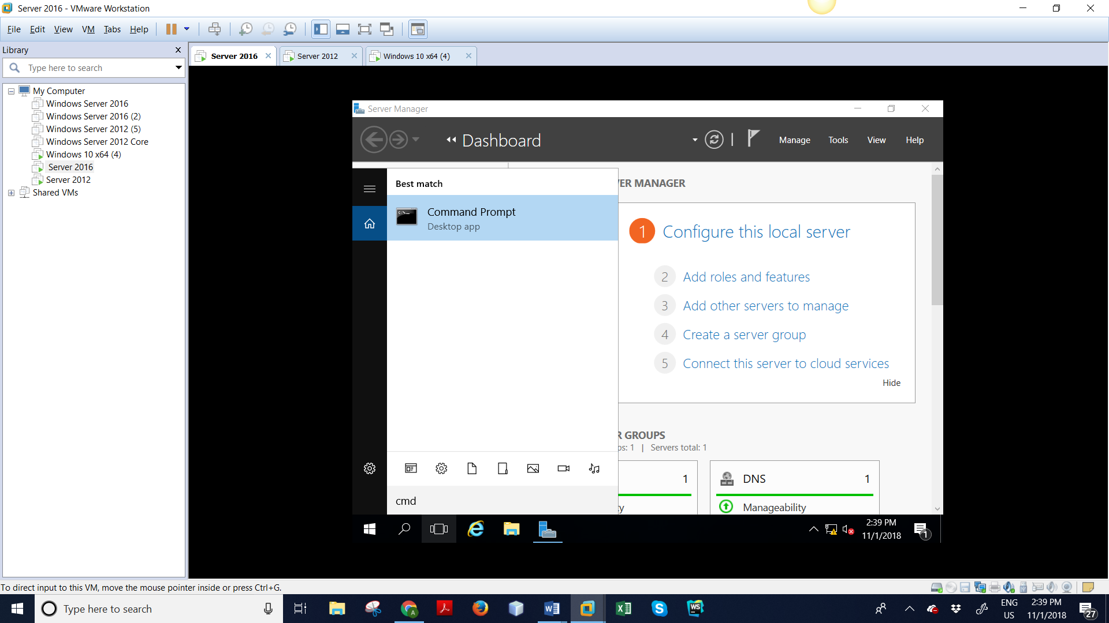
STEP 38: Go to command prompt

Slide 48
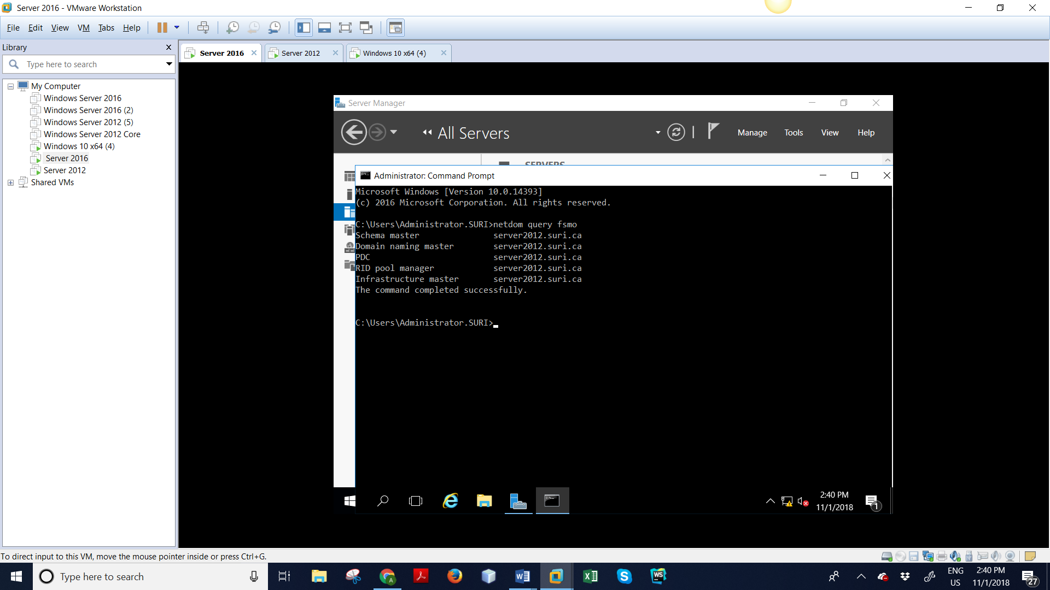
Step: 39– Transferring FSMO roles from server 2016. Go to server 2016, open command prompt. Type “netdom query fsmo”. It will show server which is having five FSMO roles.

Slide 49

Step: 40 – Type ntdsuti, type roles in ntdsutil, type connections in fsmo maintenance, then type connect to server parth.patel.ca in server connections.

Slide 50
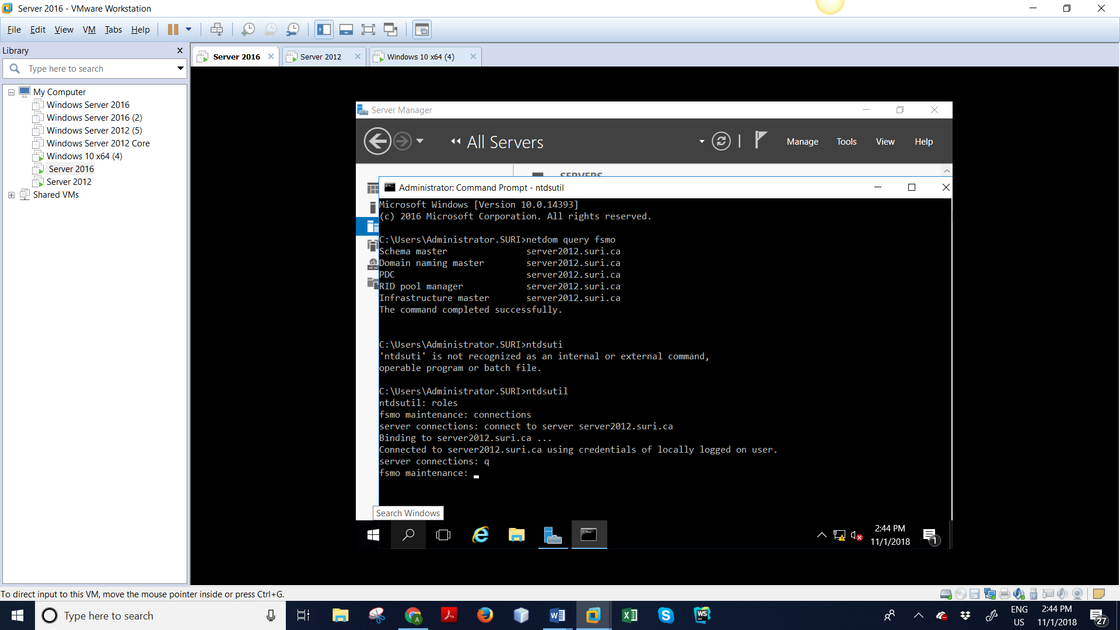
Step: 41 – It’s connected to domain with valid credentials. Type q then

Slide 51
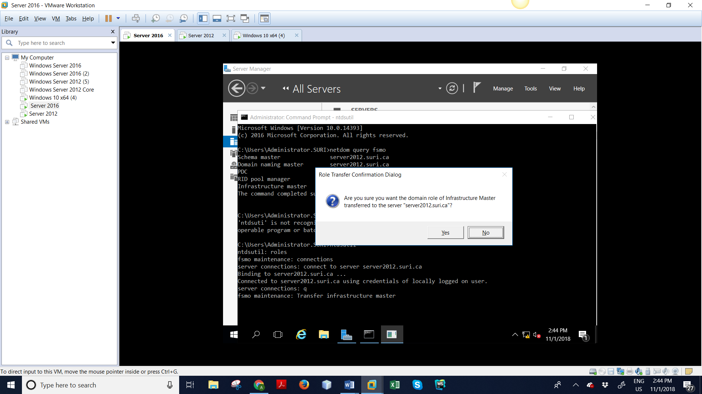
Step: 42 – Type “Transfer infrastructure master”, transferring first role of fsmo. Click Yes then.

Slide 52
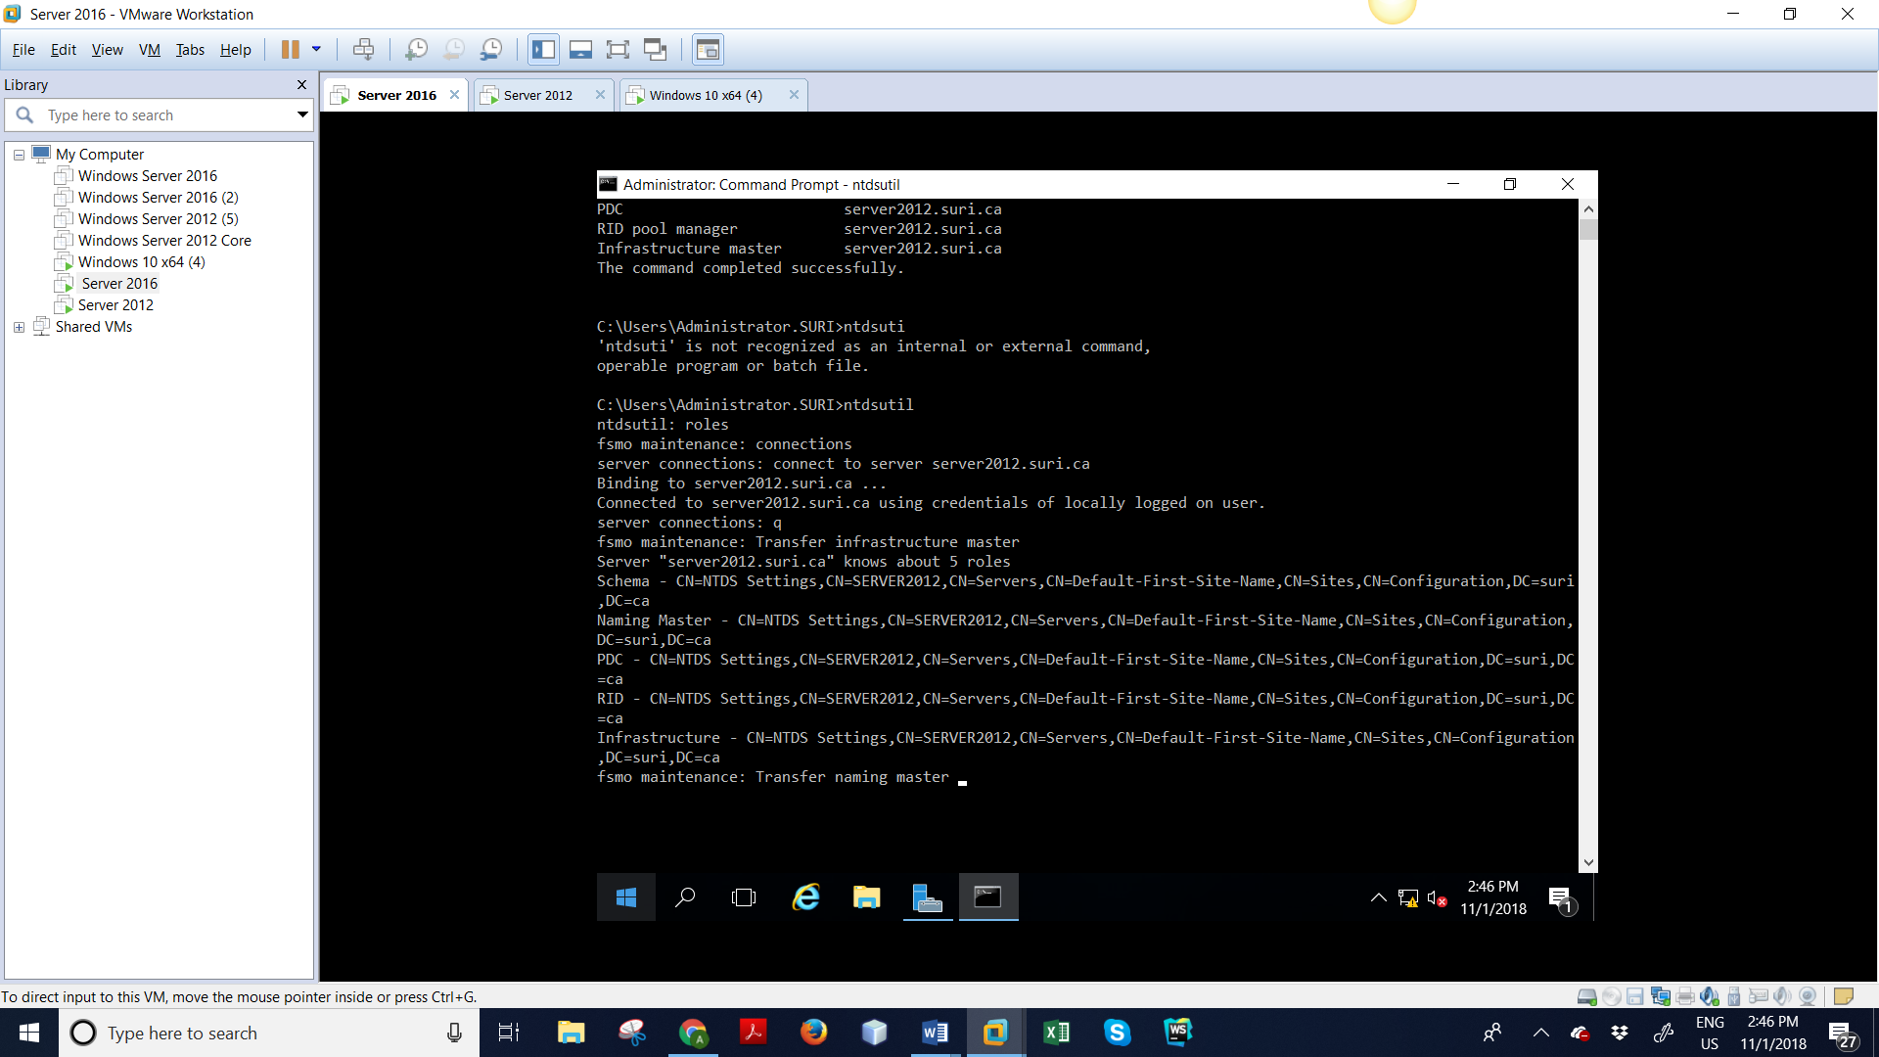
Step: 43– Type “Transfer naming master ”

Slide 53
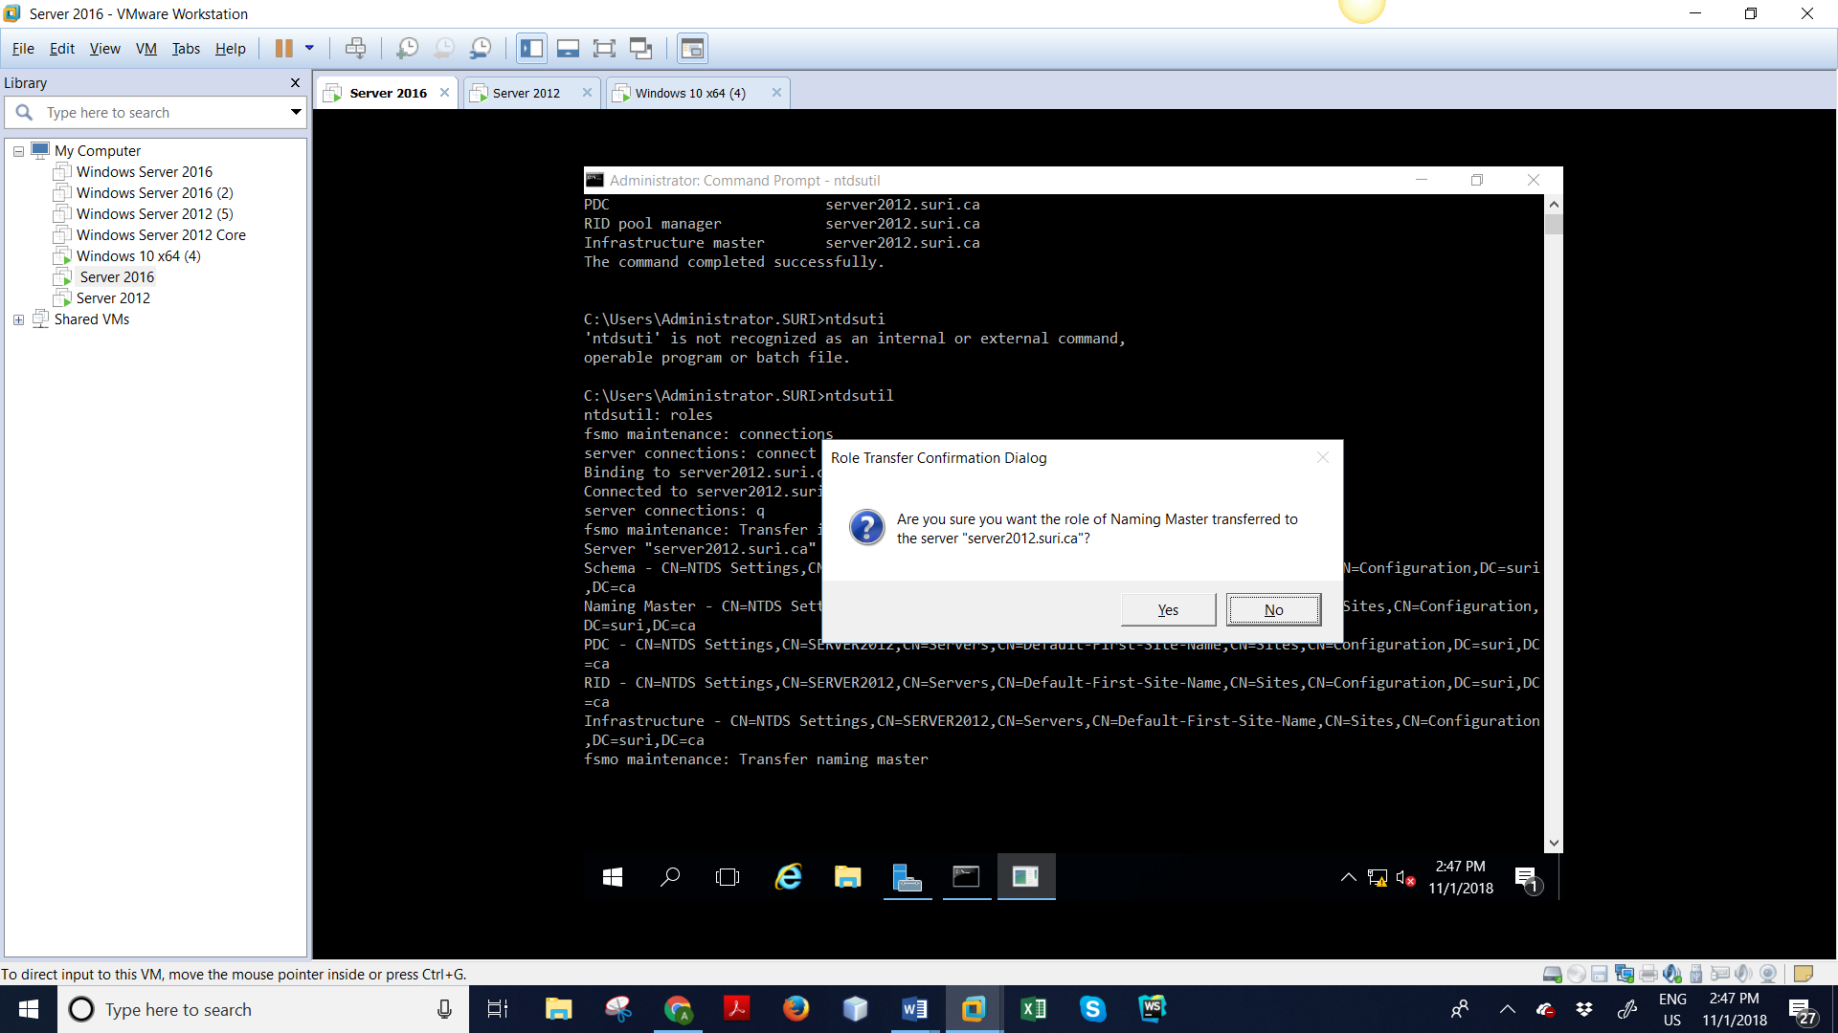
Step: 44– Click Yes

Slide 54

Step: 45– Type “Transfer PDC”

Slide 55

Step: 46– PDC successfully transferred.

Slide 56

Step: 47– Type “Transfer RID master”

Slide 57
Step: 48– Type “Transfer schema master”

Slide 58
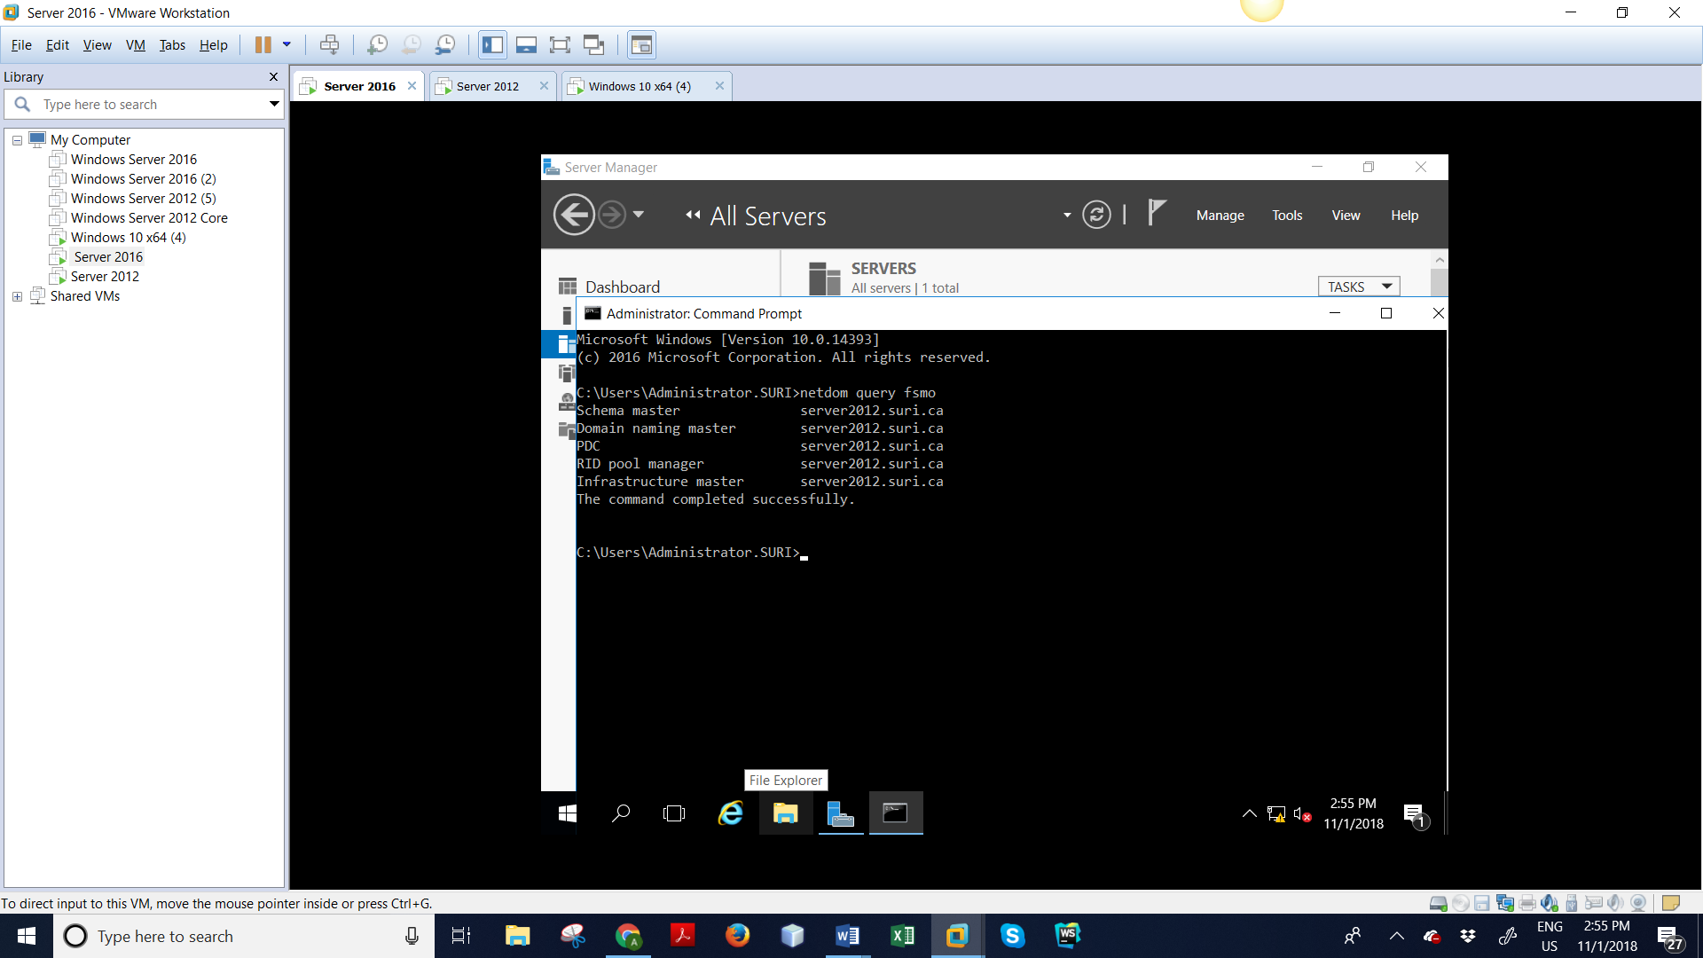
Step: 49– Type “netdom query fsmo”. We can see all the fsmo roles transferred into server 2016. It’s showing server 2016 as domain controller.

Slide 59
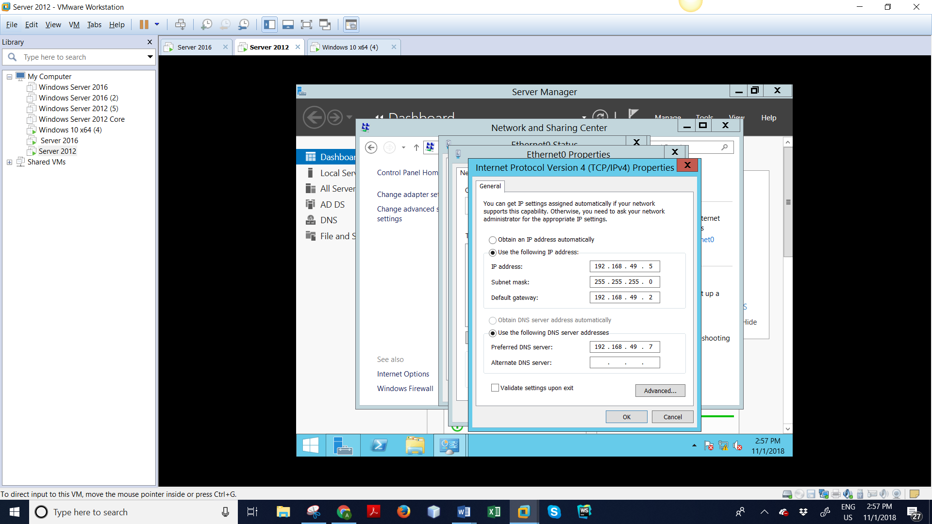
Step: 50– Go back to server 2012, and change DNS server IP address same as the server 2016.

Slide 60

Step: 51– Click on Manage > Remove Roles and Features.

Slide 61

Step: 52– click Next then.

Slide 62

Step: 53 – Make sure sever is selected, click Next then.

Slide 63

Step: 54 – Uncheck “Active Directory Domain Services”, then click on Remove Features.

Slide 64

.

Slide 65

Step: 55 – It will throw Validation Results window. It says Active Directory Domain Controller need to be demoted first. Click on Demote this domain controller

Slide 66

Step: 56 – Leave by default setting as it is. Click Next

Slide 67

Step: 57 – Checkbox “Proceed with removal

Slide 68

Step: 58 – Enter server 2012 password.

Slide 69

Step: 59 – Review the selections,

Slide 70

Step 60 : - then click on Demote.

Slide 71

Step: 61– Demoting is in process. It will restart server 2012 after finishing it.

Slide 72


Slide 73

Step: 61 – Go to server manager of server 2012. Click on Tools > Active Directory Users and Computers. Expand suri.ca > Domain Controllers. You can see SERVER2016 computer, which is controlling the domain.

Slide 74

Step: 62 – Server 2012 is working as a computer in the domain and no longer remains a Domain Controller, but still it is a part of a domain. Migration is successful.

Slide 75

Finally migration is complete

